Slide 1
Lecture 2
Simulation, Optimization and Machine Learning in companies

Slide 2
Today
What are simulation, optimization and machine learning
Examples

Slide 3
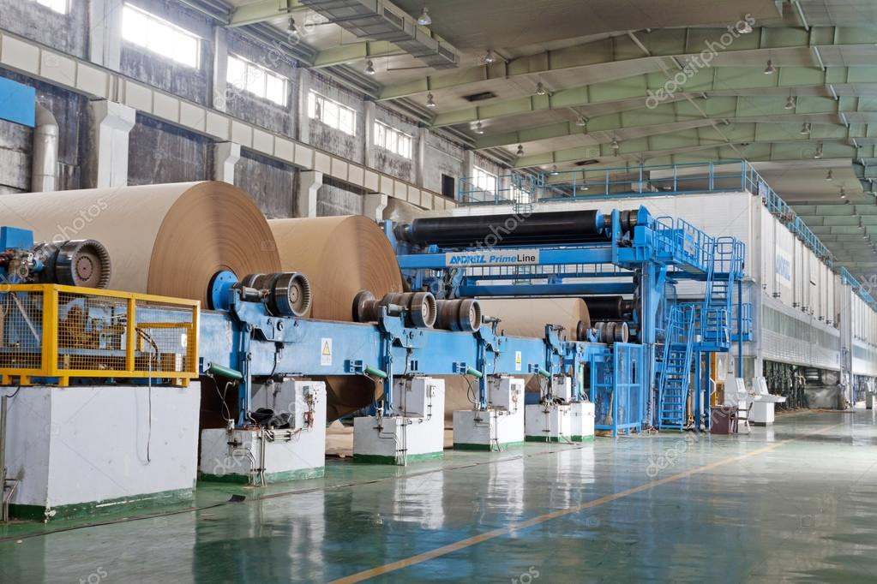
Simulation – Running a toilet paper machine
A paper producing line makes several types of toilet paper.
Preparing the machine to produce a different toilet paper is a multi-hours, many people, expensive operation
When changingover, the machine doesn't produce any goods

Slide 4
Simulation – Dilemma
Long runs, few changes
Short runs, many changes
Pros
  More efficiency (less time wasted changing)
  Less cost (changeovers cost money)
Cons
  More stock of the goods being produced, warehousing cost
  If we run out of another good, we will have a bad time catching up
Pros
  Less warehouse costs
  Easier to avoid stockout of a single good
Cons
  Less efficiency (more time wasted changing)
  More cost (changeovers cost money)

Slide 5
Simulation – Dilemma

Slide 6
Simulation – Making things muddier
Changeover time is uncertain (sometimes things get complicated)
Changeover times between different products are different
Demand is uncertain

Slide 7
Simulation – Think
How do we do this?

Slide 8
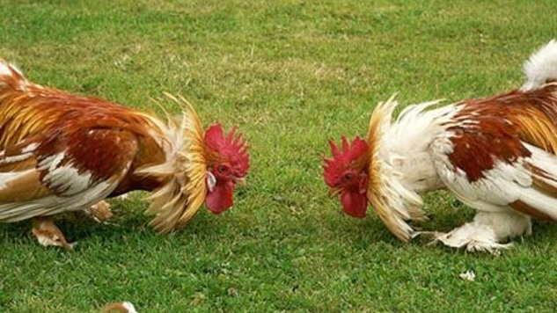
Simulation – The usual methodology
Chicken fight
  Teams at the factory want long runs because that makes their boss happy
  Teams that serve supermarkets want to never stock out (i.e. short runs) because that makes their customers happy (and their bosses too)
  Teams at the warehouses are mostly ignored unless the warehouse gets so full that nothing fits in
The final decision ends up somewhere in between

Slide 9
Simulation – The right way
Make simulation engine with all the relevant parts
  Demand (and its uncertainty)
  Changover time (and its uncertainty)
  Warehouse constraints
Use it to test different strategies
Observe outcomes and pick "best"
  Machine efficiency
  Warehouse usage
  Stockout probabilities

Slide 10
Simulation
Model the different components of a system (also known as building a digital twin)
Leverage our knowledge from statistics to represent uncertainty
Run simulations, observe results, learn

Slide 11
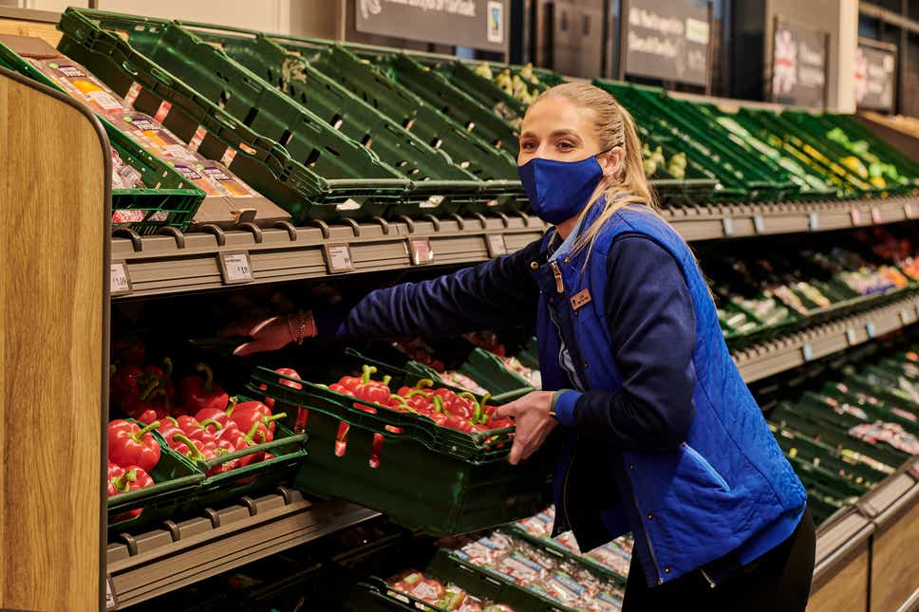
Optimization – Organizing a supermarket
A supermarket chain needs to schedule shifts for their 40,000 store employees
For each store, and each hour, for the next year
You need to cover both worker contracts/rights and the needs of each store

Slide 12




Optimization - Data
For each store and hour
  How many people are needed in different sections (Cashiers, warehouse, meat, fish, home delivery, etc.)
For each employee
  Weekly hours
  Stores he/she can go to
  Skills (can he/she cut meat)
  Regulations (max. overtime, breaks, etc).

Slide 13
Optimization - Think
How do we do this?

Slide 14
Optimization – Manual, decentralized way
Good
  Well, at least it's a way to do it
  Human touch
  You can blame people when problems arise
Bad
  Consumes tons of effort
  Human errors will happen
  Hard to track if supervisors are following policies
  Does not scale. More stores, more work

Slide 15
Optimization – More constraints
Surprise: you need to ensure you have a plan for the next 365 days every day

Slide 16

Optimization – The right way
Of course, we optimize
Define mathematical model where
  Points are earned for satisfying store needs
  Points are removed for not respecting worker constraints
Run it daily overnight, send it to everyone at 6am

Slide 17
Optimization
Family of methods to choose the best(ish) solution for a problem
We define problems as mathematical functions to maximize/minimize
Great solution as long as we have all the data and we understand reality deeply
Our friends in industrial engineering know plenty about this (Operations Research)

Slide 18
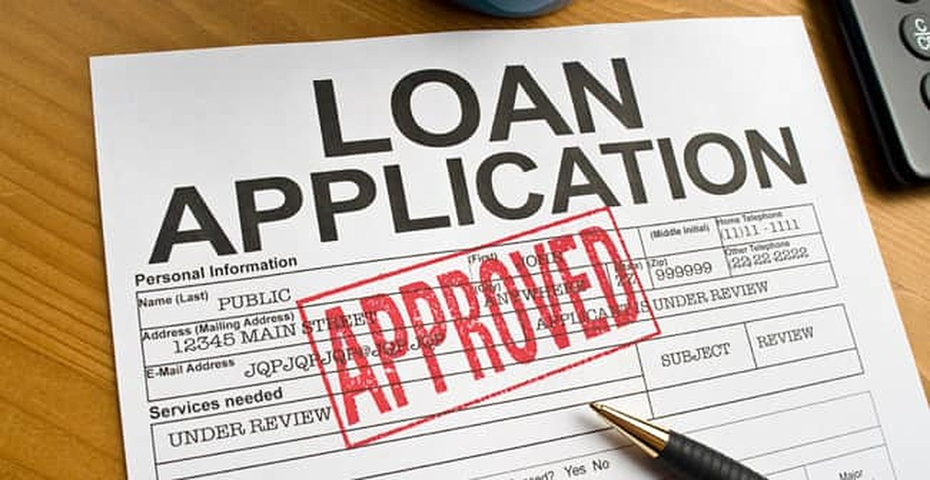
Machine Learning – Assessing loans
A bank provides loans to earn a profit
Loans come with risk of default
Each loan application needs to be assessed and decided upon: approve or reject

Slide 19

Machine Learning – Money on the table
Trade-off between risk and benefit
Too greedy: you will get a lot of defaults
Too conservative: you are leaving money on the table

Slide 20
Machine Learning – Think
How do we do it?

Slide 21
Machine Learning – The right way
Make a data based classification algorithm with historical data
Machine learning model learns how good a candidate is
Algorithm tuning allows the bank to pick the desired risk level

Slide 22
Machine Learning
We learn to predict through examples of real data
No assumptions made: all the tuning comes from inferring relationships from dta
With data large and good enough, very complex relationships can be learned

Slide 23
Common points
Applied math
Need data (usually, a lot of data)
Implementation done through software
Huge opportunities
Can be applied in many domains

Slide 24
Execution in real life
Need a mix of roles
  People who understand the business and can frame the problem
  People who know these techniques
  People who can design and deploy IT systems to execute these techniques
As diverse and messy as people are
Frequent pain points
  Poor problem/business case definition
  Unrealistic expectations
  Lack of data in usable format

Slide 25
Next up
Finish making groups for next week
Keep working on Python prep (more instructions this weekend)
View Primer's video on simulating a pandemic
(Optional) Go through this review on Agent Based Modelling

