Slide 1
Lecture 9 Workshop 2
Simulation based Optimization (2)

Slide 2
Today
A different view on simulation based optimization
A real case to put your brains to work

Slide 3
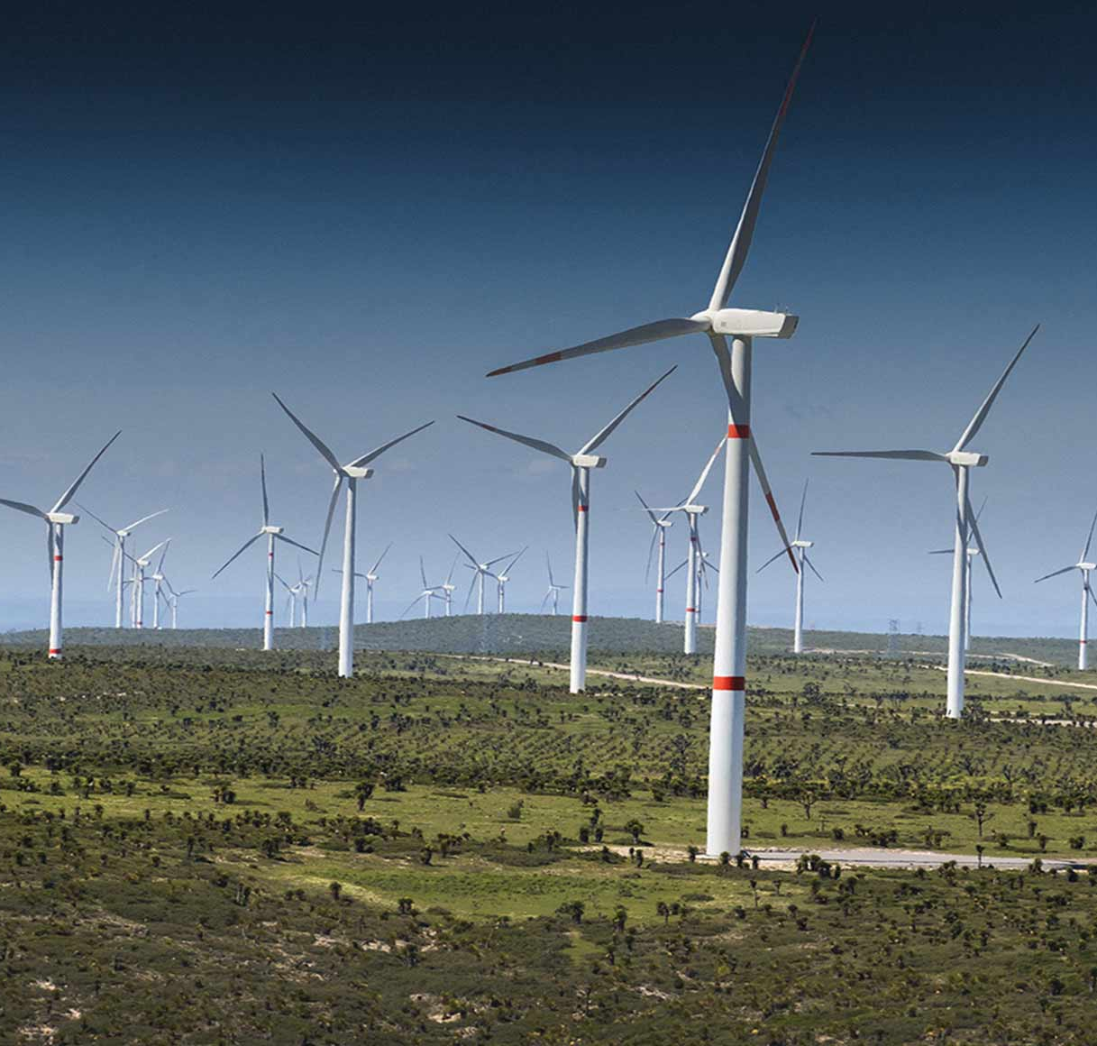
Mills Inc
Mills Inc builds eolic parks
Construction operations are long, expensive projects with budgets on the hundreds of millions of $
Material supply is key to the operation profitability. Late delivery, insufficient material or high cost will make operations unprofitable

Slide 4
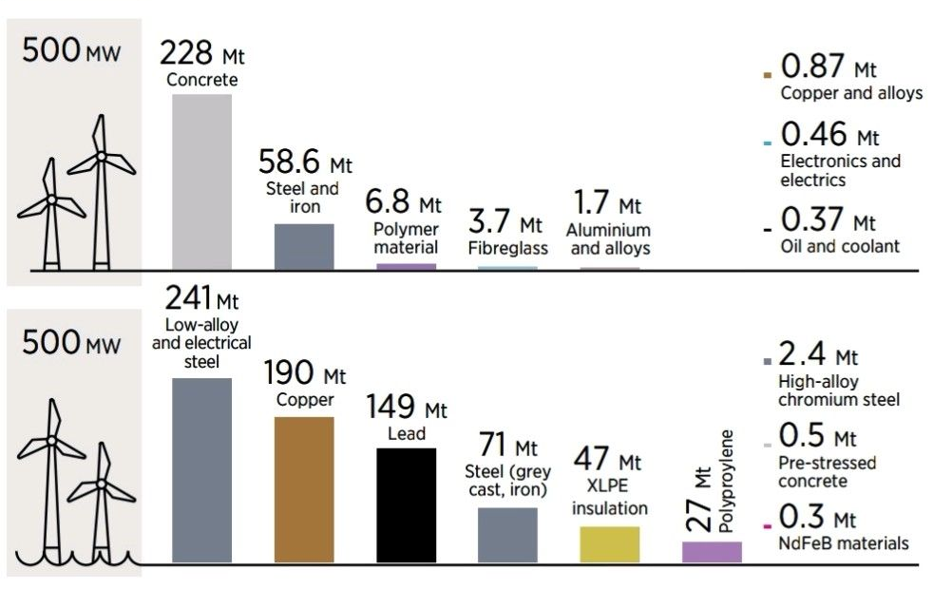
Building gigantic towers takes a bit of effort
An eolic park contains thousands of tons of different materials
Exact composition varies depending on technical features and if location is ground or sea
Concrete, steel and copper are the most consumed materials

Slide 5
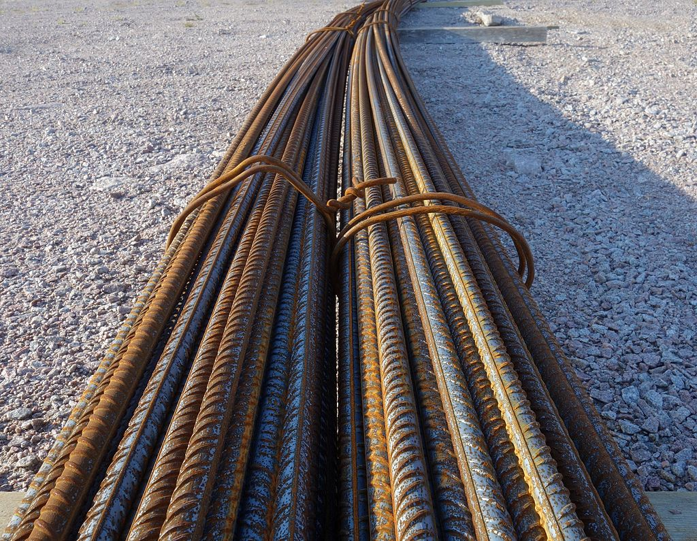
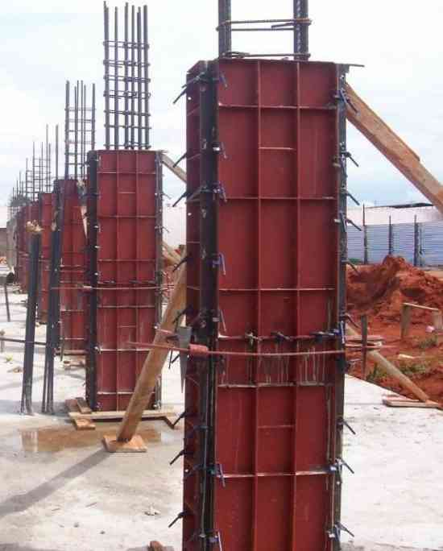
Steel Reinforcement Bars
Steel is an alloy of iron with a bit of carbon.
Steel Reinforcement Bars (Rebar for friends) are one of the most popular steel
Steel rebar goes into concrete to improve tensile strength (acts like a bone)
Very common in all sorts of construction works, including residential buildings

Slide 6
Steel as a traded commodity
Steel is so standard and has such large volume that it trades in financial market
Both spot and futures market exist
Steel Rebar is traded in the London Metal Exchange and the Shanghai Futures Exchange
https://www.lme.com/Metals/Ferrous
http://www.shfe.com.cn/en/products/SteelRebar/

Slide 7
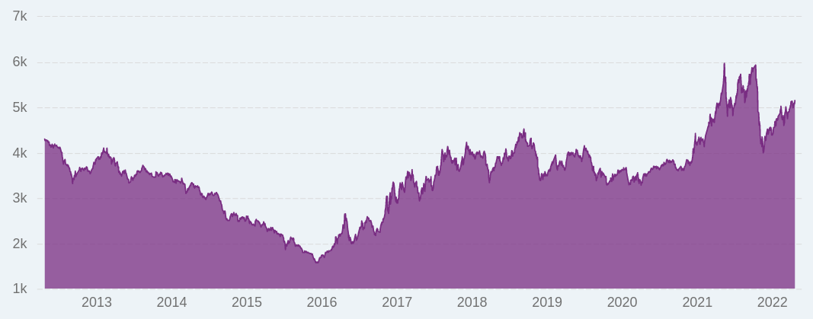
Mills Inc
Mills Inc can spend between 10 to 100 million USD buying steel rebar for an eolic park
Hence, savings opportunities are measured in millions
But the price of steel is volatile

Slide 8
An example operation
An eolic park will begin construction in the state of Rio Grande do Norte on April 2023.
After the initial designs, there is an expected need of 20,000 metric tons of steel rebar.
Joao, one of the procurement analysts of Mills Inc, is in charge of securing the steel for the operation.

Slide 9
Thinking time
What are the factors that drive Joao's decision?
What is he really trying to do?
Do we need more information?

Slide 10
Simpler worlds
What should Joao do in...
  A world where the price of steel is constant?
  A world where the price of steel is always increasing?
  A world where the price of steel is always decreasing?

Slide 11
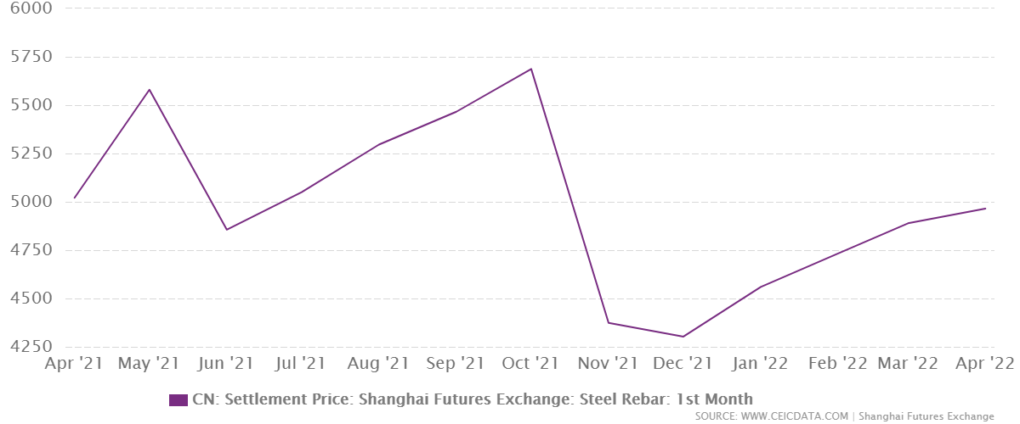
Optimizing with knowledge
Imagine we know the prices for the next 12 months
How can we use optimization?

Slide 12
Not so simple worlds
Now assume there are Working Capital Costs
How does that change things?

Slide 13
The real world
We don't know what the price will be
What do we do?

Slide 14
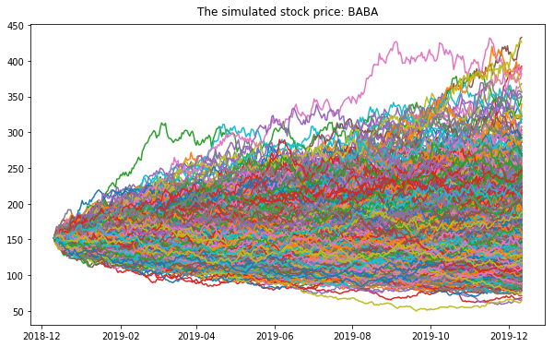
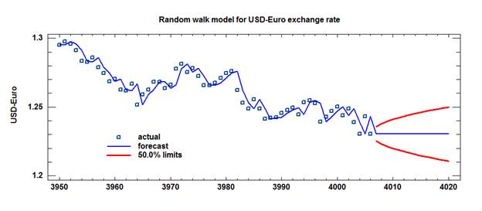
Price is uncertain, but can be bounded
We are not certain on what prices will look like in the future
But we can estimate the probability of certain price ranges
We won't cover how to do this today, but it can be done in smart ways

Slide 15
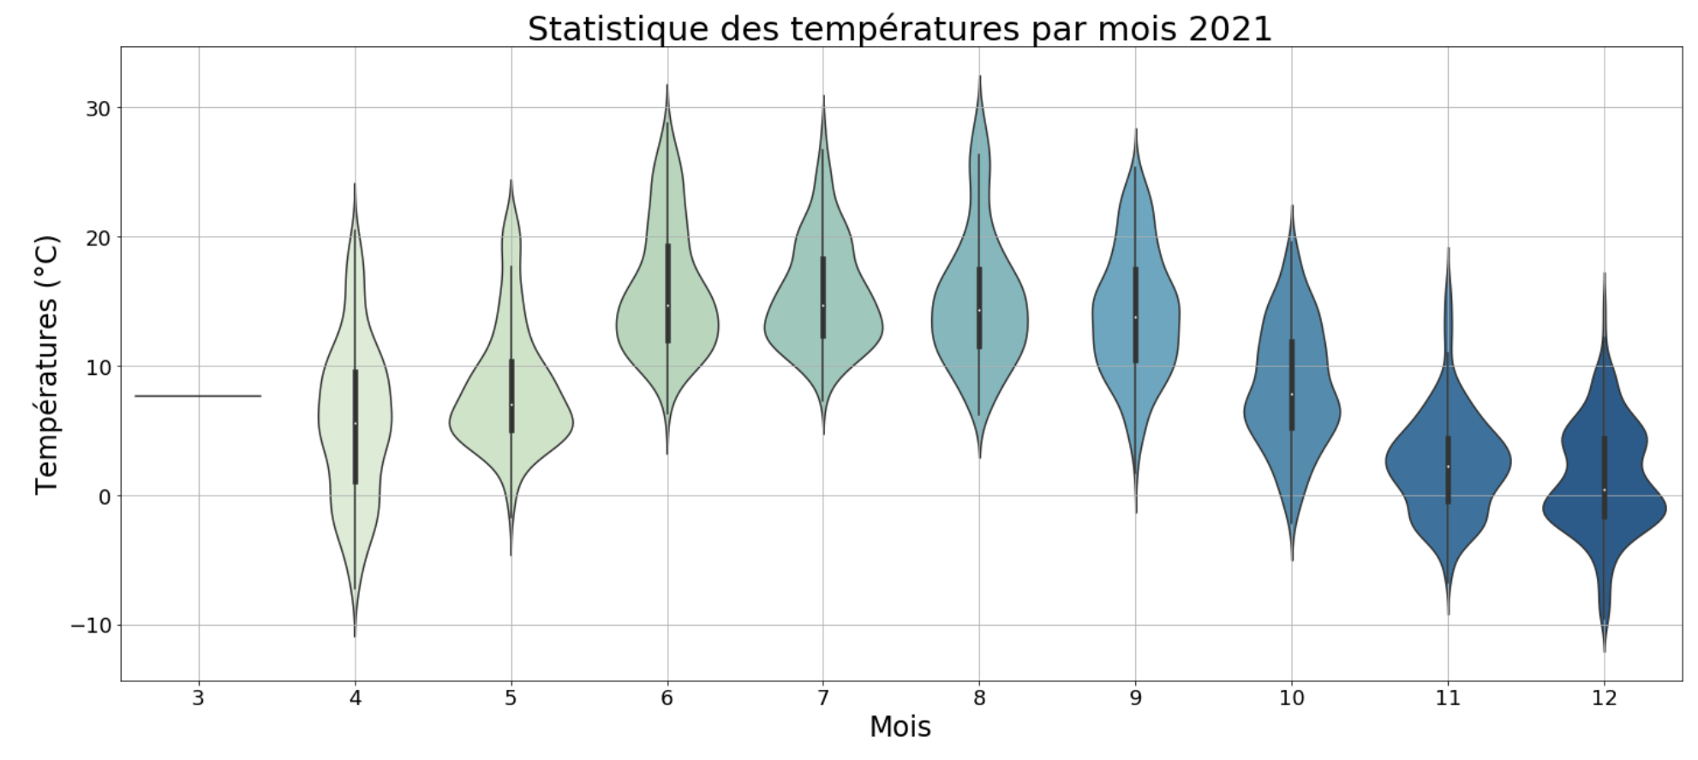
We have a probability distribution for every month in the horizon

Slide 16
Optimization and uncertainty...
We have seen how we can optimize if we know the prices
We have a probabilistic description of what prices will be like
What's next?

Slide 17
Montecarlo Simulation
What you did in case 1
Simulate prices repeteadly, optimize for each random price combination
What results do we get?

Slide 18
Results
For any given price combination...
  … we get the right purchases to make
For any specific purchase pattern...
  … we get the distribution of expected costs
With all simulations...
  … you can build a distribution of the expected cost of the operation

Slide 19
What happened in real life
We built a Machine Learning forecasting model for the price of steel
We create an app where the purchaser inputs the details of the operation (needed material, budget, transport/storage/capital costs, etc)
The app simulates different purchasing decisions and compares their outcomes in terms of expect cost and risk of exceeding the budget
The user can deep dive into each purchasing decision and its outcomes and use all the data to support their final decision

Slide 20
Real world factors that also come into play
You might need different amounts of steel at different points in time: no need to have everything for one specific month
Transport costs and storage costs are also relevant and also have uncertainty
Exchange rates are also relevant and also have uncertainty

Slide 21
There are companies making a living out of this very problem
https://decisionnext.com/

Slide 22
Next up
Work on case 2
You didn't get the free license from Gurobi, did you?
Get ready to start our Machine Learning focus with this wonderful Ted Talk (Jeremy Howard – The wonderful and terrifying implications of computers that can learn)

