Slide 1
Lecture 8
Optimization: Sensitivity Analysis - Solvers and Deployment

Slide 2
Today
Sensitivity Analysis
On solvers
  Why are they relevant
  Model vs Interface vs Solver
  Main features
  How to compare and choose

Slide 3
Sensitivity Analysis
Many times, uncertainty exists but we simply ignore it
Understanding how stable/fragile our obtained solution are to change is important
This practice is called Sensitivity Analysis
http://science.mq.edu.au/~dbulger/LPIllustration.html

Slide 4
Solvers
Systems to solve (duh) modeled optimization problems
The details are important when you choose one
Putting it simply, no solver, no optimization

Slide 5
Solvers – The inner workings
The main actions executed by a solver are:
  Read a problem model
  Identify what kind of problem it is (in mathematical terms)
  Pick the right algorithm to find a solution
  Apply the selected algorithm
  Give back results

Slide 6
Read a problem model
Solvers don't model for you. They only solve models you build.
Different solvers read models differently.
Some tools and softwares allow you to model once and change dialects to several solver standards

Slide 7
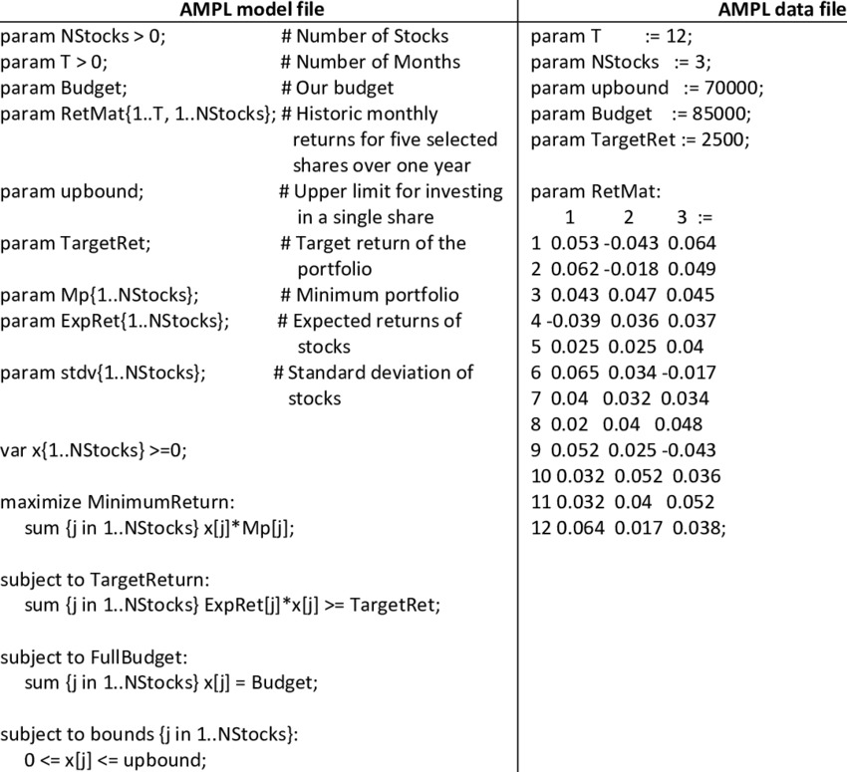
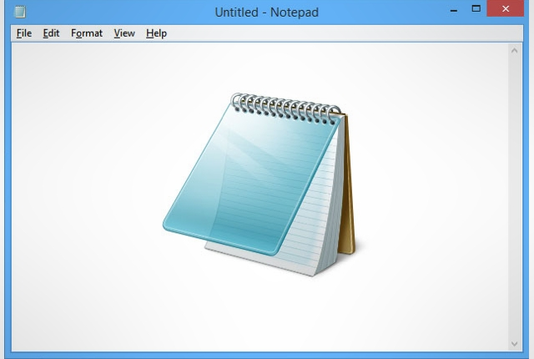

Jumping from humans to machines is messy
You load the file in an AMPL environment with a client library or interface
AMPL calls the Gurobi solver engine to execute and solve the model
You write the AMPL file

Slide 8
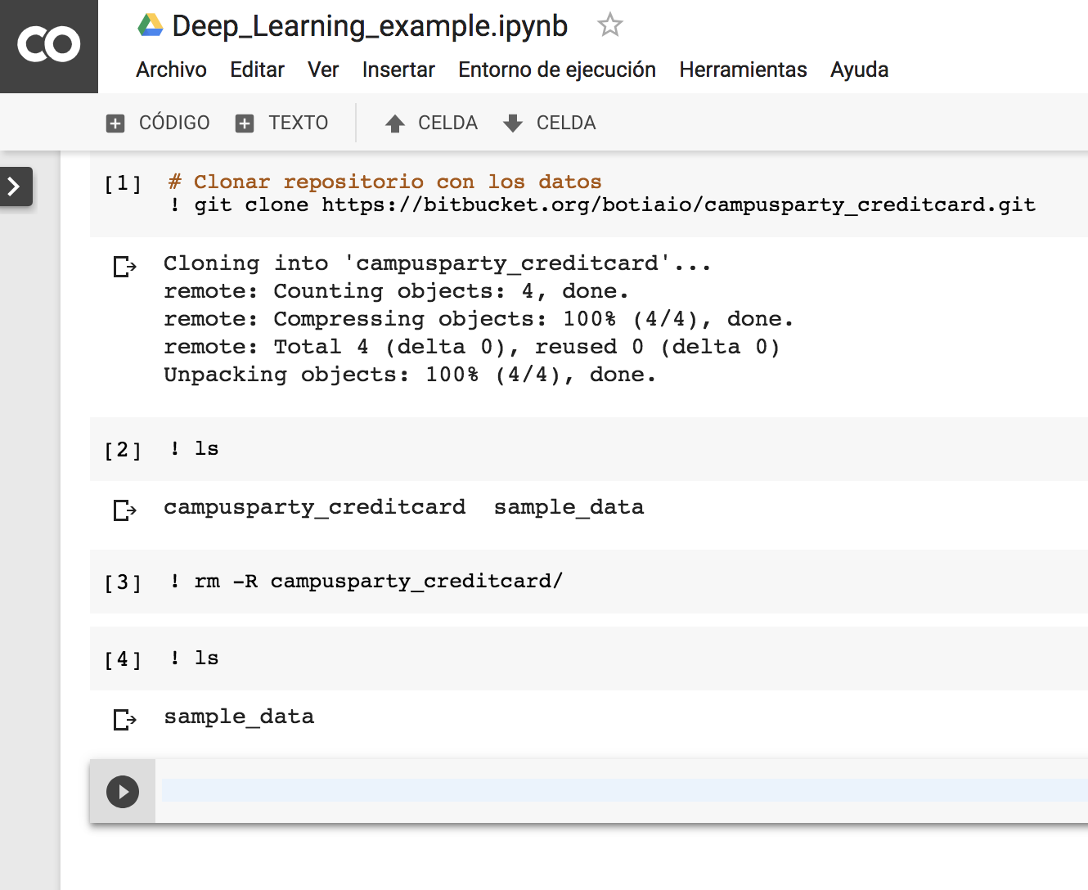
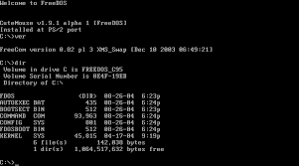

Jumping from humans to machines is messy
PuLP creates a bunch of temporal files and calls the CBC solver through command line
The CBC solver activates and solves the model
You write Python + PuLP code

Slide 9
Model vs Interface vs Solver
A solver receives a problem (through a file, through a command line call, by clicking on a button in a user software) and solves it
A model definition is a description of a problem. It can be code, it can be a text file, it can be some obscure binary file.
A code interface is a software package that promises that, if you write a certain code, it will build a model for one or more solvers (like PuLP does)

Slide 10
Identifying the problem type
The solver must decide what algorithm to use
The choice depends on what kind of problem is being faced

Slide 11
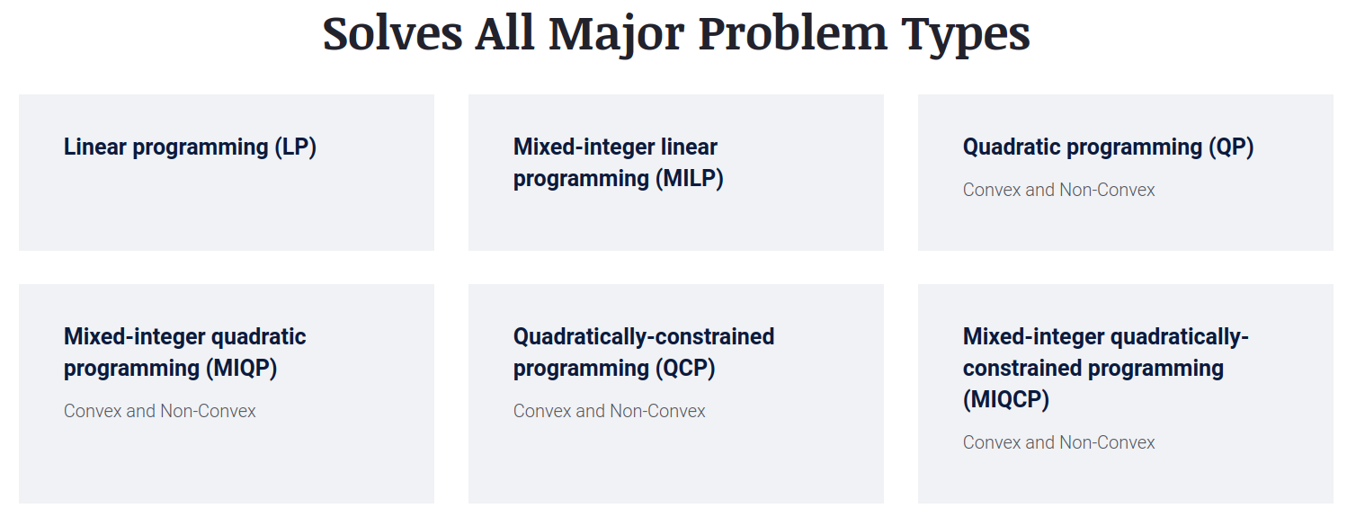
Gurobi Optimizer problem families

Slide 12
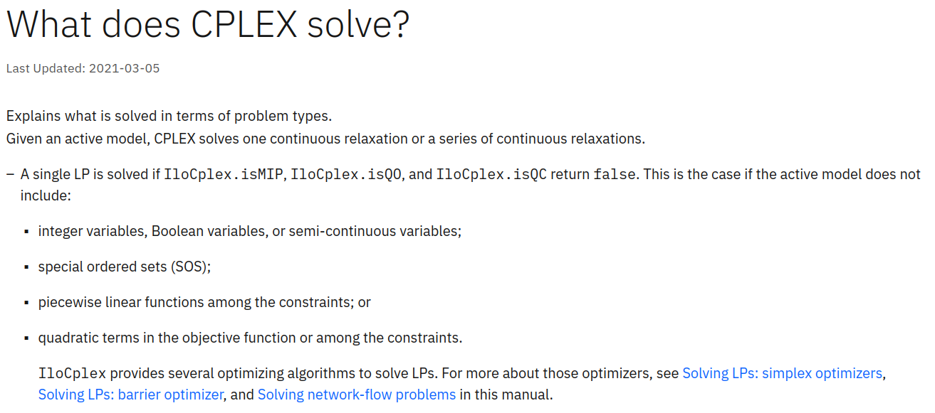
CPLEX

Slide 13
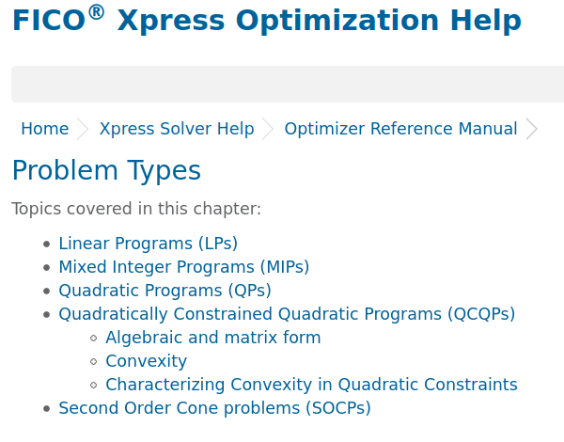
Fico Xpress

Slide 14
Different problems need different algorithms
Problem | Algorithms
Linear Programming | Simplex, interior-point, Ellipsoid Method
Integer Programming | LP Relaxation, Cutting Plane, Branch and Cut
Quadratic Programming | Interior-point, Active Set, Conjugate Gradient Method
Quadratically Constraint Quadratic Programming | Semidefinite Programming, Reformulation-Linearization techniques
Second Order Cone Programming | Interior-point, Semidefinite Programming

Slide 15
Wow, do I need to know all of those?
Relax, the solver will spot the right one
But don't play ostrich: being aware of what problem are you facing is important

Slide 16
Beware of snake oil salesmen
Employees from commercial software companies will always reply "Yes" when asked if their software is the right tool for any job
Alternatively, if their software doesn't solve an advanced problem type, their engineers might try to convince you that:
  the problem is too hard for anyone to solve (might or might not be true)
  You can achieve a simpler formulation for your business problem (not necessary a bad idea)

Slide 17
Applying the algorithms
Solver takes care of it
On some problems, performance is relevant. Again, evaluate differences between solvers, specially if speed is relevant

Slide 18
Results
The basic stuff
  What is the final value for the target function
  What is the solution (decision variables values)
More exhaustive
  Alternative optimal solutions if more than one exists
  Senstivity analysis details

Slide 19
How to choose a solver
Suitability to your problems
Money
Available knowledge and skills
Fancy features

Slide 20
Surviving with no money
The best quick and dirty solver is hidden in Excel
Alternatively, there are open source optimization solvers
  CBC
  GLPK
  Lpopt
  Gekko
  Pyomo
  OR-Tools
Neos server allows you to use commercial solvers through their web page, as long as it's not for commercial purposes (but they won't ask)
Any commercial solver will give you all you want for free if you are a student

Slide 21
Deployment patterns
How you are going to use optimization software is also relevant for your choice
Are you...
  Going to make one shot, throw-away, ad-hoc analysis?
  Going to embed optimization within an application?
  Going to build an automatic system that

Slide 22
Excel's Solver
https://support.microsoft.com/en-us/office/load-the-solver-add-in-in-excel-612926fc-d53b-46b4-872c-e24772f078ca

Slide 23
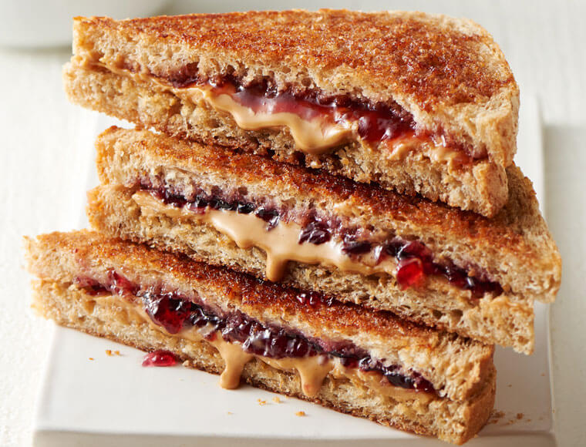
Example
I need make my lunch. I will eat a peanut-butter sandwich
I'm hungry as hell, so I want as many calories as possible
But my doctor has me on a diet. I must eat at least 1.5 grams of protein for each gram of fat
I have 200 grams of peanut-butter
I have 300 grams of bread
What should my sandwich look like?
Item | Peanut Butter | Sandwich bread
Calories per 100g | 588 | 267
Fat per 100g | 50g | 3g
Protein per 100g | 25g | 11g

Slide 24
Next up
Work on case 2
Check Gurobi's page in case you want to try their software or get trained further
  (You can request free-licenses today by proving you are a student. If you do that, you can also request licenses during the 12 months after your graduation. It's free and it only takes a bit of time, you might regret not doing it)
(Optional) Practice using Excel's solver. It's a great skill for life

