Slide 1
Lecture 6
Introduction to Optimization

Slide 2
Today
What is optimization
Applications
Why is it useful
Drawbacks

Slide 3
What is optimization
Define a real-world problem as a function and a set of equations
Apply an algorithm that maximizes or minimizes that function
The result is our optimal solution to the problem

Slide 4
Modeling a problem
Three elements:
  Decision variable: what we need to choose/decide
  Target function: our description of what "good" means
  Constraints: what is possible and what not
Let's do an example

Slide 5
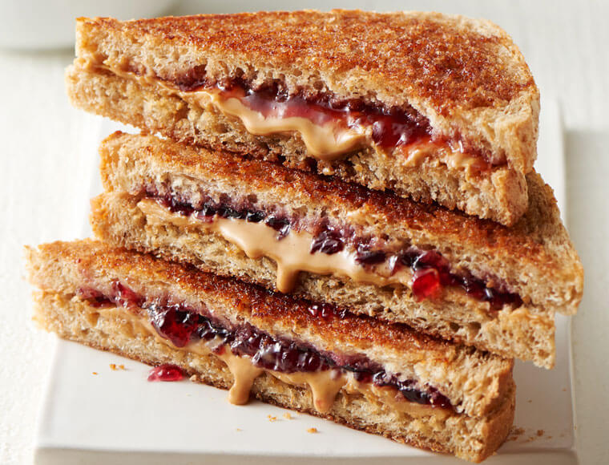
Example
I need make my lunch. I will eat a peanut-butter sandwich
I'm hungry as hell, so I want as many calories as possible
But my doctor has me on a diet. I must eat at least 1.5 grams of protein for each gram of fat
I have 200 grams of peanut-butter
I have 300 grams of bread
What should my sandwich look like?
Item | Peanut Butter | Sandwich bread
Calories per 100g | 588 | 267
Fat per 100g | 50g | 3g
Protein per 100g | 25g | 11g

Slide 6
Solving the model
Models are optimized with solvers (aka an algorithm that finds the optimal decision variable values for you)
The right solver for your problem depends on how you modeled your problem
Some problems are easy and have straigthforward solvers, some problems don't have solvers at all
Let's solve the previous model

Slide 7
Ramping up
How do I solve if I have:
  100 ingredients
  Restrictions on what mixes with what (I won't eat shrimps with Nutella)
  50 dietary rules from my doctor
?

Slide 8
Simplex – The classic solver
https://youtu.be/RO5477EKlXE?t=234

Slide 9
Linear Programming
Maximizes or minimizes a target function
Contains constraints
There are "alternatives": there is something we can control or modify
All equations are purely linear: no ifs, no ^2, no logs, etc.

Slide 10
Other areas out there
Integer linear programming
Mixed integer linear programming
Quadratic programming
Non-linear programming
Mixed integer quadratic programming
Mixed integer non-linear programming
Quadratically constrained quadratic programming

Slide 11
Feasibility
Sometimes, no solutions exist
If this is problematic, you might want to relax your constraints

Slide 12
Applications
Sky is the limit! If you can model it properly, you can optimize it
A few examples:
  Meal and diet design
  Workforce scheduling
  Investment portfolio design
  Transport planning

Slide 13
Why is it useful
Some optimization models can solved:
  With guaranteed optimal solutions
  Fast
Can deal with large problems fast, if modeled properly
White-box: the details on the solution and the procedure are clear and can be examined

Slide 14
Drawbacks
We need a thorough understanding and specific numbers
Doesn't enjoy uncertainty
Real life situations become complicated equations very-very-very fast

Slide 15

Sandwich details
Solution (39PB, 300B)

Slide 16
Next up
Finish case 1
(Optional) Go through a nicer explanation on the Simplex algorithm

