Slide 1
Lecture 4
Simulation Methodology

Slide 2
Today
Methodology
Available Technologies for implementing
Roles

Slide 3
Methodology
Initial framing
Gather data
Model
Run
Analyse
Take action

Slide 4
Methodology – Initial Framing
What are we going to simulate?
What are the individual components?
How do they relate?
What data do we need?
What input will the simulation have?
What characteristics are we going to observe?
How are we going to explore the simulation space?

Slide 5
Methodology – Gather data
Ways to obtain data:
  Historical
  Forecast
  Assumptions/Expert input
Certain data? Just plug the numbers in.
Uncertain data? Use empirical and theoretical distributions.
Garbage in, garbage out. Careful with bias.

Slide 6
Methodology – Model
Conceptual first, implemented after
Continuous or discrete time?
Philosophy
  Discrete event simulation
  Process based simulation
  Agent based modelling
  Free-form

Slide 7
Methodology – Run
Implement in a software environment
Design and execute experiments
Store data on the state of the simulation
State t
State t+1
State t+2
State t+3
State t+4
Events
Events
Events
Events

Slide 8
Methodology – Analyse
Scientifical approach
  Good for keeping things tidy and if you have a very specific scope
  First, come up with hypothesis or questions
  Then, use the obtained data to validate/answer them
Exploratory approach
  Shoot first, ask later
  Start simulating, obtain some results
  Iterarte and explore behaviour as you go until you are satisfied

Slide 9
Methodology – Take action
You were not simulating just because, right?
Use the obtained conclusions to drive business action/take decision/implement best course of action

Slide 10
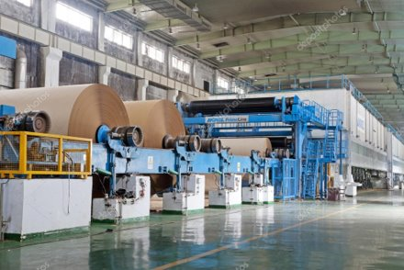
Methodology – Revisiting an old friend
Initial framing
Gather data
Model
Run
Analyse
Take action

Slide 11
Technologies for implementation
Three main clubs
  Propietary software solutions
  Open-source frameworks
  Innovators
And finally... you can always roll your own

Slide 12




Propietary software

Slide 13



Open source frameworks

Slide 14

Innovators

Slide 15
Roll your own
If you can code, you can simulate
Good solution situations where you need something:
  Simple and fast
  Highly customized
Large, complex simulations are not easy to build. Be careful.

Slide 16



Roles
The Business
The Modeler
The Engineer
Business Analyst / Manager of XXX / <Insert any business title here>
Data Scientist / Operations Research Expert / Applied Mathemathician
Data Engineer / Software Engineer / Solutions Architect / Backend Dev.
Defines the problem
Defines what a good solution looks like
Provides business context and data
Creates and evaluates models to solve the problem
Explores data to find new insights
Implements and deploys models and data pipelines
Maintains the system up and running

Slide 17
Next up
Keep on working on case 1
(Optional) Review HASH market simulation

