Slide 1
Lecture 3
Simulation: Introduction

Slide 2
Today
What is simulation modeling
Applications
Why is it useful
Drawbacks

Slide 3
What is simulation modeling
Code a copy of reality (the simulation)
This representation can "run" (typically, move through time)
We can observe the state of the simulation as it runs
We can learn things about reality from the simulation

Slide 4
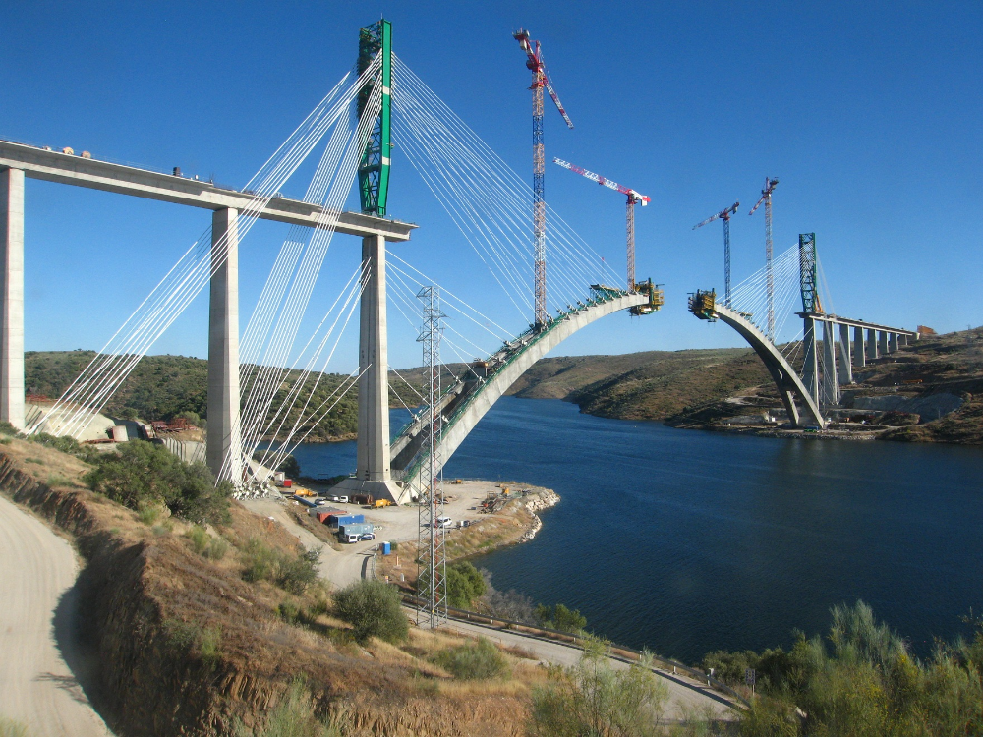
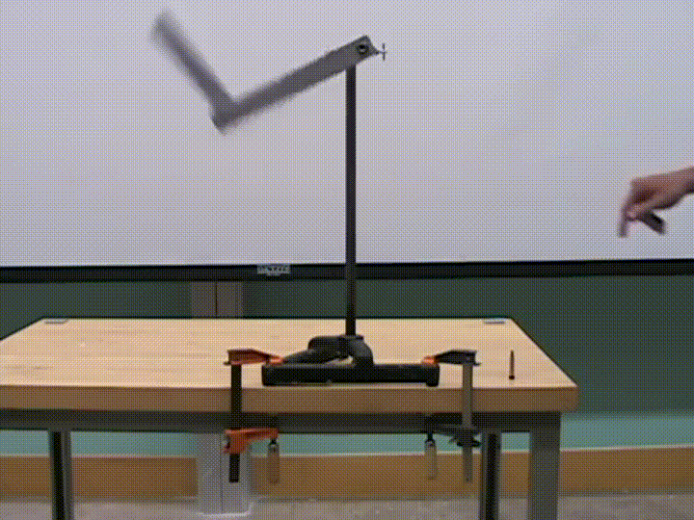

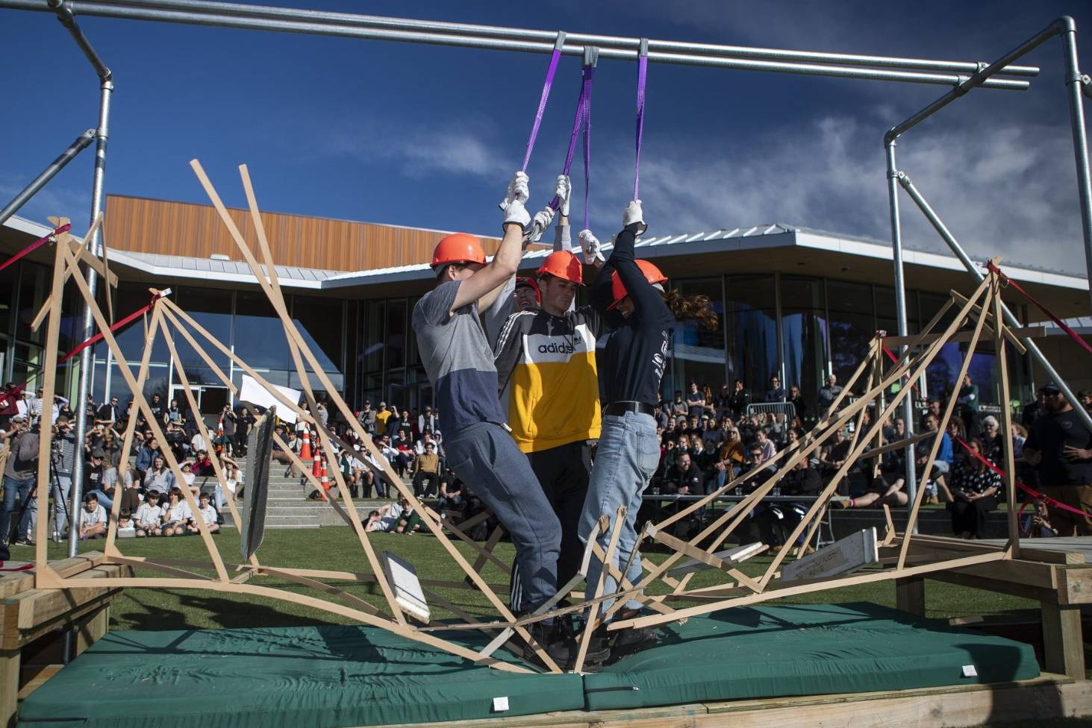
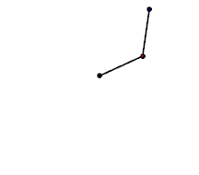
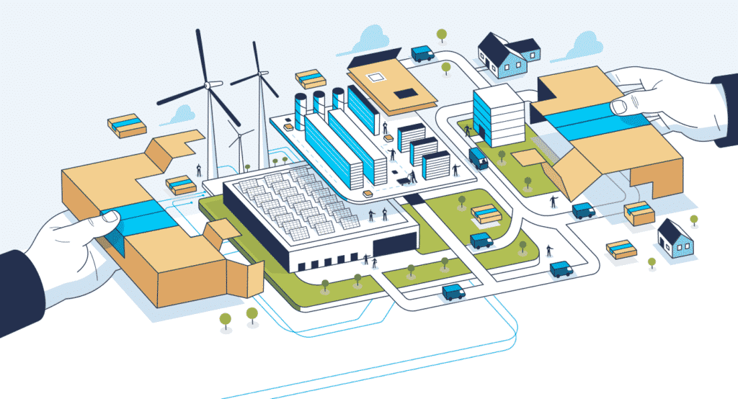
A copy of reality

Slide 5
"Run" the simulation
Put people on it
Run through continuous time
Run through discrete time (each hour, each day, each week, etc).

Slide 6
Observe the state
Is it stable?
Does it has cracks or fractures?
Is it broken?
What is the angel?
What is the position of the third point?
What is the potential gravitational force of the second point?
What is the stock level?
How many orders did we serve today?
Which resources are idle?

Slide 7
Learn about reality
This bridge can hold 30,000 tons without collapsing.
The maximum kinetic force of the edge is enough to kill someone, thus this design is unsafe for a factory.
If we close our warehouse in Bilbao, our logistics network will turn into chaos.

Slide 8
Your turn
Can you think of examples of simulations?

Slide 9
Higher order applications
Assistance to human judgement
Prediction of results
Optimizing decisions/Finding best solutions
Understanding a complex system

Slide 10
Why simulation?
Simpler and cheaper than other options
Deals with uncertainty easily
Can uncover complex systems behaviour

Slide 11
Simpler than other options
An example with pirates and dices

Slide 12
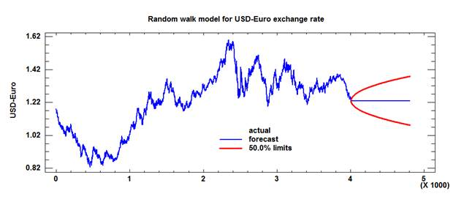
Deals with uncertainty easily
Behaviour of uncertain phenomena can be represented as random variables
An example: currency rate exchange

Slide 13
Can uncover complex system behaviour
Simple, individual components combined generate unpredictable, rich behaviours
Examples: an economy, the human body, a supply-chain

Slide 14
Complex systems
Animal traffic jams: https://core.hash.ai/@hash/ant-foraging/7.5.0
Human traffic jams: https://core.hash.ai/@hash/traffic-basic/stable

Slide 15
Drawbacks
Garbage in, garbage out
Modeling still requires smart brains
Computational limitations – You can't simulate everything you will ever want
Searching for optimals solutions is not easy

Slide 16
Wrap-up
Simulation is about imitating the real-world and examining our copycat models
Some of its characteristics make it very attractive: simplicity, uncertainty tolerance, complex systems analysis
But it's not a miracle nor a silver bullet

Slide 17
Next up
Tomorrow you must have a group
Read case 1 description and related materials, tomorrow we will discuss them

