Slide 1
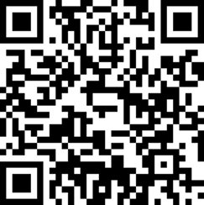
Lecture 16
Deploying in real life; Exam and Course Q&A

Slide 2
Today
Deployment
Exam
Open Q&A

Slide 3
Thinking time
Imagine Estefanía loves your ML model
She wants to use it
How does she do it?

Slide 4
Deployment
Once you have built something great, it problably needs to live somewhere
Placing software in a server to be used by people (or other software) is what we call deployment

Slide 5
Do I need to know how to deploy?
It kind of depends of who you want to be in life
Typically, more associated with Software Engineers and Data Engineers
But, if you want to progress in the field, it won't hurt to know the basics

Slide 6
Simulation example
Let's place ourselves in case 1 again
You build a great simulation based optimization engine. Elisa wants to update the purchase policy every month automatically
The changes should be stored and implemented in Beanie Limited's operational systems

Slide 7
System and Data Flow
Server
ERP
Optimal purchase policy
MRP Module
Your simulation
engine
Real Demand or Forecasts
Sales
Module
Inventory state and PO data
Inventory
Module

Slide 8
Machine Learning Example
Server
Scheduling Software
Engine-off time predictions
Your ML Model
ERP
Client and orders data
Position and time data
Fleet Management System

Slide 9
Real life problems
There is no data at all
There is data, but is a complete and utter mess
There is data, but the size is huge
People who have the problems don't know the solutions
People who have the solutions are not familiar with the problems
Teams of data scientists + data engineers get expensive fast
Unrealistic expectations on performance
Lack of general mathematical literacy

Slide 10
Real life problems
The guys who run the system you need data from are not available or don't care about your project
The guys who need to set up servers for your are not available or don't care about your project

Slide 11
Exam
50% quick, short answer questions
50% longish cases
Equal weight for simulation, optimization, ML
You only need a pen
Easy to pass, hard to get a 10

Slide 12
Q&A
Does it make sense to look at model parameters across the different fold of a K-fold cross validation to measure robustness?

Slide 13
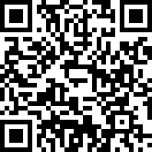
Next up
Deliver case 3
Send me your life/studies/work questions for tomorrow's Q&A
Fill the form if you want to come have a drink after the exam
Make your voice heard, evaluate my work

