Slide 1
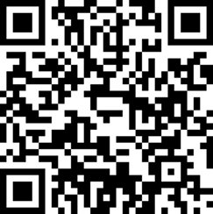
Lecture 15
Ensemble Learning; Hyperparameter Tuning

Slide 2
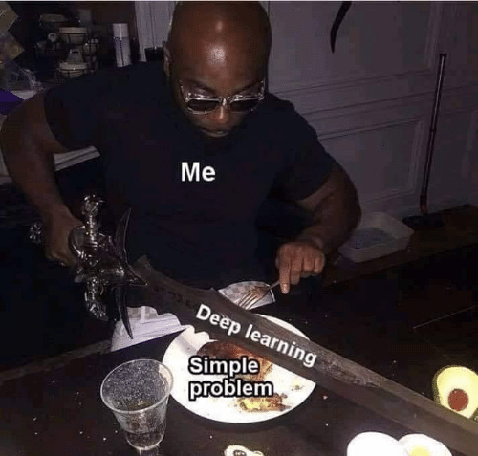
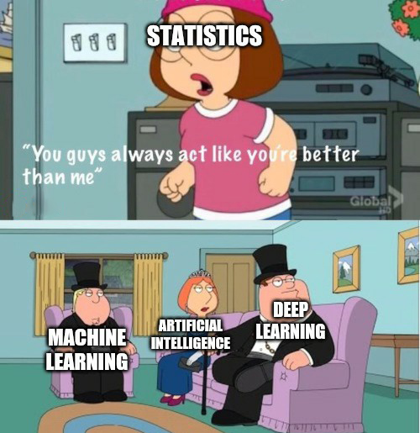
Now that you know a bit, you will start enjoying memes

Slide 3
Today
Ensemble Learning
Tuning hyperparameters

Slide 4
Ensemble Learning
Yesterday we learned about Random Forests
Random Forest are an example of Ensemble models
Ensemble methods are models built with multiple sub-models
  The sub-models are the ensemble
  The final prediction is made by aggregating ensemble results

Slide 5
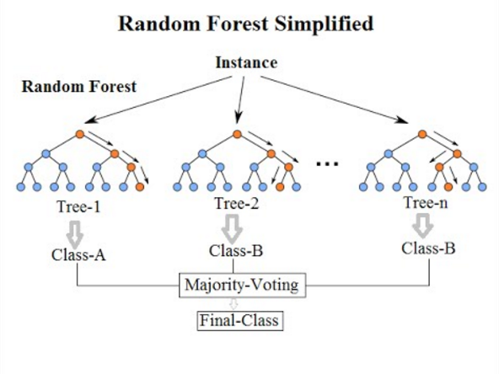
Random Forest

Slide 6
Three ways of building ensembles
Bagging
Boosting
Stacking

Slide 7
Bagging
We alread covered yesterday
Sample the training data with replacement repeateady
Train different models on different samples
Aggregate the results

Slide 8
Boosting
We also have many weak learners
But we train them differently from bagging

Slide 9
Loss functions and getting funky
Earlier, we introduced that ML is actually optimization in disguise
One take-away from our optimization classes is that we can get creative with our target function

Slide 10
Thinking time
Why would we modify our ML loss function (aka target function)?

Slide 11
Take-away
We can modify loss functions to adjust results

Slide 12
Boosting
We also have many weak learners
But we train them differently from bagging
We train learners sequentially and increase focus on mistakes

Slide 13
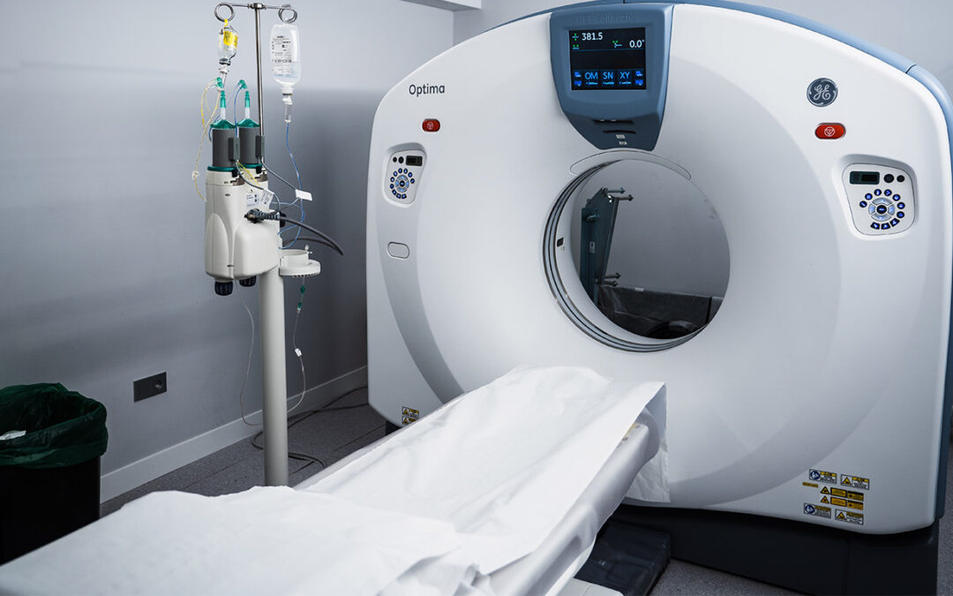
Thinking time
Why would we modify our ML loss function (aka target function)?

Slide 14
Thinking time
Why would we modify our ML loss function (aka target function)?

Slide 15
Random Forests are great
They work much better than decision trees
But why?

Slide 16
Training several trees
What happens if:
  I grab a training dataset
  I build a tree two times
?

Slide 17
Training several trees – this doesn't work
I will get the same tree twice*.
This is not really useful, is it?
*This is true for popular algorithms like ID3 or C4.5, but it might be different with other tree building algorithms or weird implementations. You can assume this is true for scikit-learn)

Slide 18
Thinking time
Why are the different trees in the Random Forest different?

Slide 19
Bootstrap Aggregating
Commonly known as bagging
Generate random samples of the original dataset with replacement
We feed the different samples to different trees. Each tree is called a weak learner

Slide 20
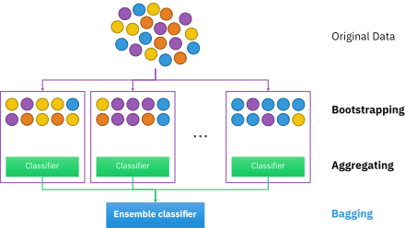
Bootstrap Aggregating

Slide 21
Thinking time
Bagging gives us different trees
Now, forget bagging
What else could we do to avoid getting identical trees?

Slide 22
Another tweak – Random Feature Sampling
We don't give all features to each tree, only part of them
Typically, the square root of the feature count (so, if we have 9 features, each tree gets 3)
Further enhances the properties given by bagging

Slide 23
Bagging + Random Features = Patches

Slide 24
Consequences of bagging
Improved performance: random forests will tipically outperform decision trees
Variance gets reduced by leaps and bounds, at the expense of having a bit more bias
Makes overfitting much more difficult
Predictions are more stable

Slide 25
Why does it work?
I wish I had a clearer explanation, but there isn't much research.
Intuitions:
  Overfitting is difficult because different weak learners focus on different parts of the dataset
  Even though each individual learner can overfit, the majority voting/aggregation cancels those out
  Learning might happen on areas of the data domain that would have been overlooked with a single, strong learner
  Increased protection from outliers

Slide 26
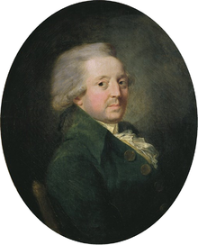
Why does it work?
Marquis' jury theorem seems to be in line
The idea is called The Wisdom of the Crowds
Marquis de Condorcet

Slide 27
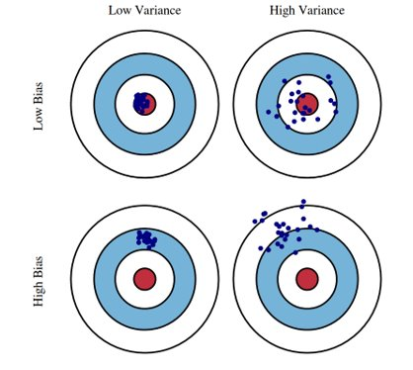
Bullseye intuition

Slide 28
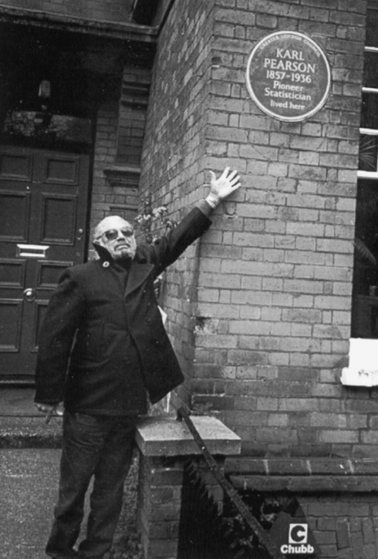
A bit of history
Leo Breiman made most of this
The Random Forest paper is roughly your age
https://www.stat.berkeley.edu/~breiman/RandomForests/cc_home.htm

Slide 29
Let's review visually
https://mlu-explain.github.io/random-forest/

Slide 30
Advantages of Random Forests
Increased performance
Less overfitting risks
More stable predictions
Robust to outliers

Slide 31
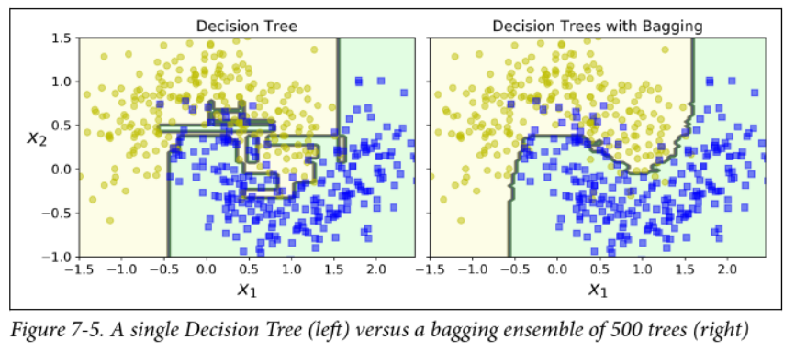
Random Forest are more stable
Less of a chance of having weird, noisy boundaries

Slide 32
Thinking time
If Random Forests are so great, why would we ever use a Decision Tree?

Slide 33
Problems of Random Forests
Inherits issue from decision trees, such as inability to extrapolate in regression
More expensive computationally
You are losing explainability

Slide 34
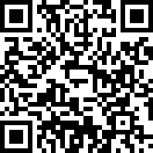
Next up
Keep working on case 3
Make your voice heard, evaluate my work

