Slide 1
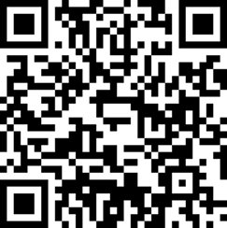
Lecture 14
Random Forests

Slide 2
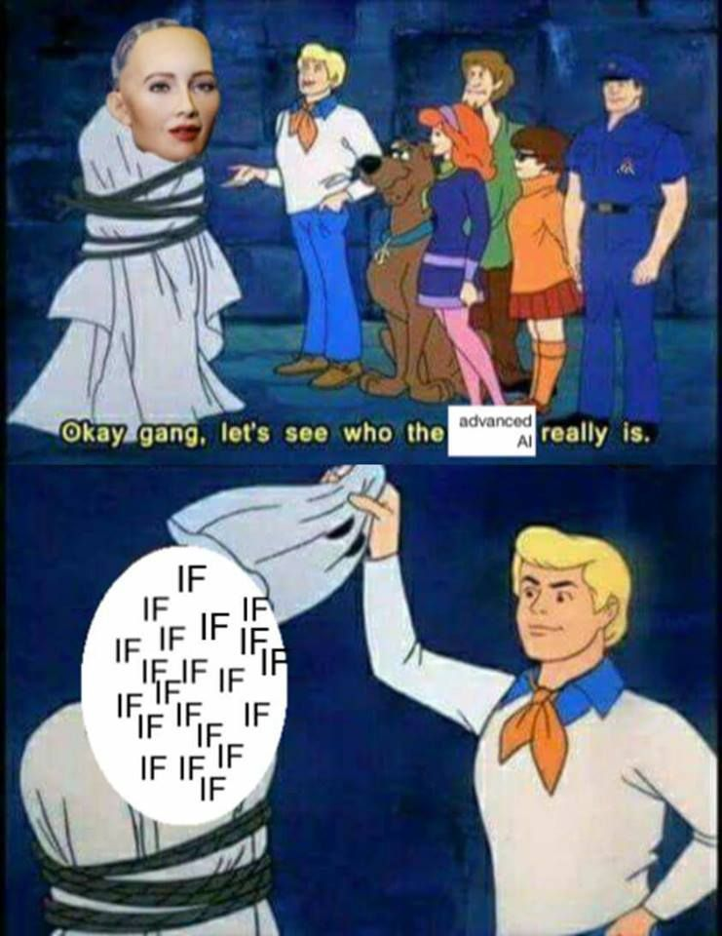
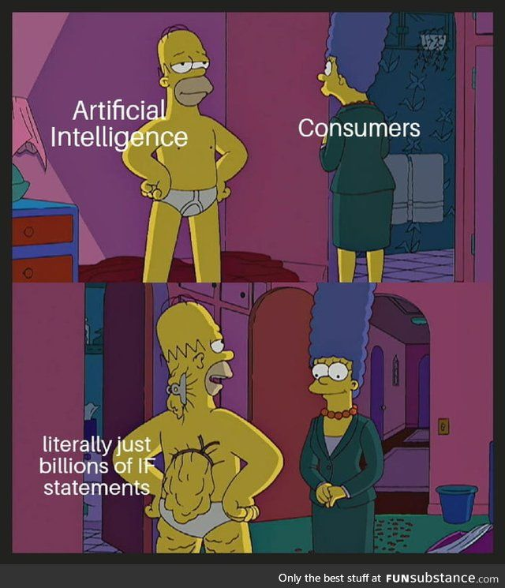
Now that you know a bit, you will start enjoying memes

Slide 3
Today
Random Forests

Slide 4
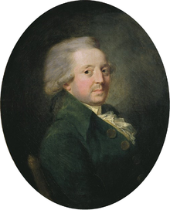
The Wisdom of ...
A group wishes to reach a decision by majority voting.
One of the two outcomes of the vote is correct, and each voter has an independent probability p of voting for the correct decision.
How many voters we should include in the group?
Marquis de Condorcet

Slide 5
… the crowds
If p is greater than 1/2 (each voter is more likely to vote correctly):
  Adding more voters increases the probability that the majority decision is correct.
  In the limit, the probability that the majority votes correctly approaches 1.
If p is less than 1/2 (each voter is more likely to vote incorrectly):
  Adding more voters makes things worse.
  The optimal jury consists of a single voter.
Marquis de Condorcet

Slide 6
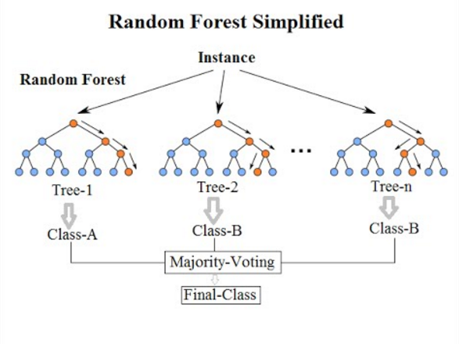
Random Forest

Slide 7
Random Forests are great
They work much better than decision trees
But why?

Slide 8
Training several trees
What happens if:
  I grab a training dataset
  I build a tree two times
?

Slide 9
Training several trees – this doesn't work
I will get the same tree twice*.
This is not really useful, is it?
*This is true for popular algorithms like ID3 or C4.5, but it might be different with other tree building algorithms or weird implementations. You can assume this is true for scikit-learn)

Slide 10
Thinking time
Why are the different trees in the Random Forest different?

Slide 11
Bootstrap Aggregating
Commonly known as bagging
Generate random samples of the original dataset with replacement
We feed the different samples to different trees. Each tree is called a weak learner

Slide 12
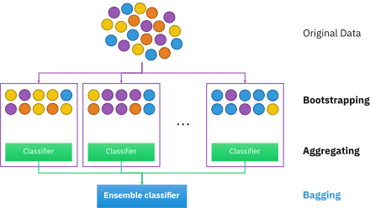
Bootstrap Aggregating

Slide 13
Thinking time
Bagging gives us different trees
Now, forget bagging
What else could we do to avoid getting identical trees?

Slide 14
Another tweak – Random Feature Sampling
We don't give all features to each tree, only part of them
Typically, the square root of the feature count (so, if we have 9 features, each tree gets 3)
Further enhances the properties given by bagging

Slide 15
Bagging + Random Features = Patches

Slide 16
Consequences of bagging
Improved performance: random forests will tipically outperform decision trees
Variance gets reduced by leaps and bounds, at the expense of having a bit more bias
Makes overfitting much more difficult
Predictions are more stable

Slide 17
Why does it work?
I wish I had a clearer explanation, but there isn't much research.
Intuitions:
  Overfitting is difficult because different weak learners focus on different parts of the dataset
  Even though each individual learner can overfit, the majority voting/aggregation cancels those out
  Learning might happen on areas of the data domain that would have been overlooked with a single, strong learner
  Increased protection from outliers

Slide 18
Why does it work?
Marquis' jury theorem seems to be in line
The idea is called The Wisdom of the Crowds
Marquis de Condorcet

Slide 19
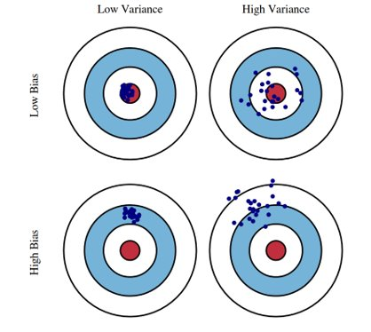
Bullseye intuition

Slide 20
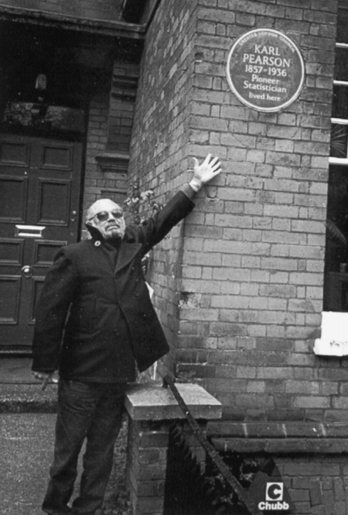
A bit of history
Leo Breiman made most of this
The Random Forest paper is roughly your age
https://www.stat.berkeley.edu/~breiman/RandomForests/cc_home.htm

Slide 21
Let's review visually
https://mlu-explain.github.io/random-forest/

Slide 22
Advantages of Random Forests
Increased performance
Less overfitting risks
More stable predictions
Robust to outliers

Slide 23
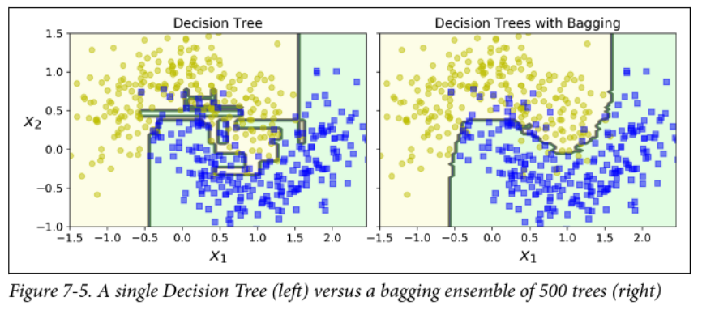
Random Forest are more stable
Less of a chance of having weird, noisy boundaries

Slide 24
Thinking time
If Random Forests are so great, why would we ever use a Decision Tree?

Slide 25
Problems of Random Forests
Inherits issue from decision trees, such as inability to extrapolate in regression
More expensive computationally
You are losing explainability

Slide 26
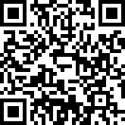
Next up
Keep working on case 3
Make your voice heard, evaluate my work

