Slide 1
Lecture 13
Overfitting and underfitting; Bias-Variance Tradeoff; Cross-Validation

Slide 2
Today
Underfitting and overfitting
Cross Validation
Bias variance Tradeoff

Slide 3
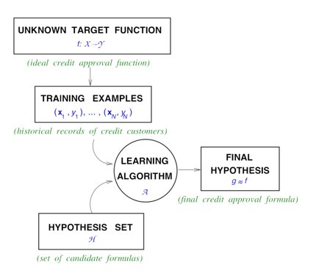
Learning
Remember, we are trying to approximate a function that exists in the real world
We do so by looking at examples of input and output (x and y) hoping that we can learn the function that way

Slide 4
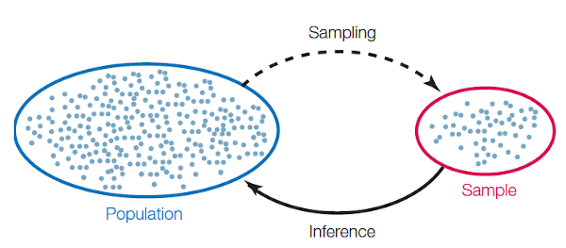
Train data is usually a sample
Our training data is a sample from the real world
We hope that what we learn from the sample will generalize to the rest of the population

Slide 5
Overfitting
Our model is learning noise from the training data
This is not real, useful inference of the real world
The performance in the training dataset looks great, but on real world data it will be terrible
Let's overfit a model so you see how it looks like
https://playground.tensorflow.org/

Slide 6
Underfitting
Our model does not have enough "complexity" to learn the real world function. It's too simple
Perfect example: a linear regression for a quadratic relationship
Performance is equally bad in the training dataset and on real world data
Let's underfit a model so you see how it looks like
https://playground.tensorflow.org/

Slide 7
Perfectfitting™
Model complexity is on the sweetspot
Complex enough to learn the real world function
Simple enough that it won't pick all the noise from the training dataset
Performance is "good" both in the training set and on real world data

Slide 8
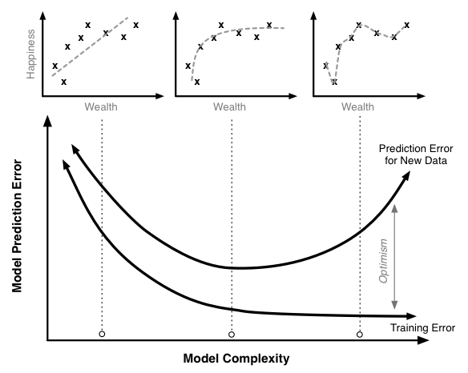
Where am I?
Impossible to know beforehand. Another place were you rely on experience and trail&error.
But you can roughly find out with some smart testing
We will discuss better later

Slide 9
How do I solve?
If you are underfitting
  Adjust parameters of your model to increase complexity (i.e. let your tree grow deeper)
  Switch to a more complex algorithm (i.e. go from linear to polynomial regression)
If you are overffiting
  Adjust parameters of your model to decrease complexity (i.e. prune your tree)
  Switch to a simpler algorithm (i.e. go from polynomial regression to a linear one)

Slide 10
Ways to prevent
Not all models are equally prone to overfitting
Use regularization

Slide 11
Regularization
We make the model pay a price for getting more complex
Different algorithms can be tuned in several ways to achieve this
We still need to decide how hard we punish the model for the additional complexity... and again, there is no clear formula for that

Slide 12
Regularization for linear regression
Modify the cost function to penalize the high value for the weights
Different styles exist: they will derive into different behaviours when training
You still need to decide your alpha lambda coefficient... again, no formula

Slide 13
Regularization for linear regression
Modify the cost function to penalize the high value for the weights
Different styles exist: they will derive into different behaviours when training
You still need to decide your alpha lambda coefficient... again, no formula

Slide 14


Regularization for decision trees
The intuition is: don't grow the tree further (make more splits), if the information gain is too small
You can also do it a posteriori when pruning
How much is too small? Again, no formula

Slide 15
Splitting data, testing and fitting
Let's say we split our dataset in training (80%) and testing (20%)
We use train for training, test for measuring performance
Can you see any problems with this approach?

Slide 16
Splitting data, testing and fitting
A lucky or unlucky split might trick you
Once you make predictions on the test set, you have "ruined it"
If you keep tuning your model further, you will end up overfitting on your test set as well
That means we only have one bullet

Slide 17
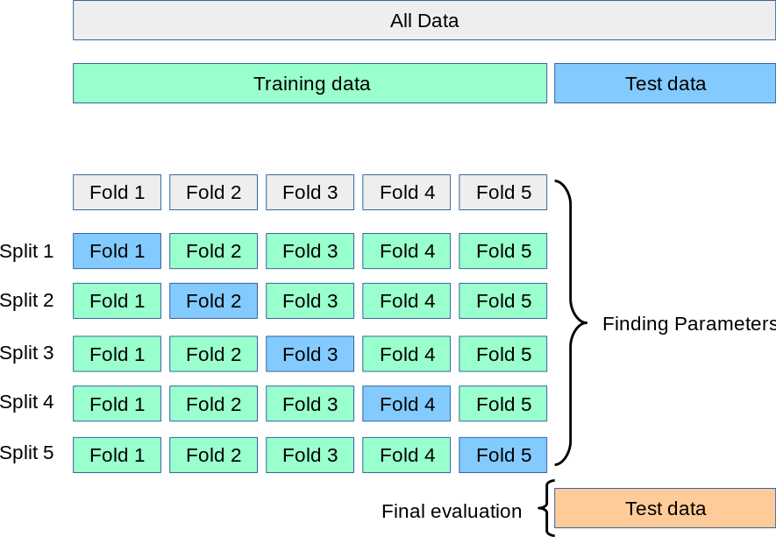
K-fold cross-validation
A neat trick to make the most out of our train set
We split the training set in several mini train-test splits
We use these to try different models and parameters without perverting the test set
Makes overfitting way harder

Slide 18
K-fold cross-validation
Let's use it to optimize our tree

Slide 19
K-fold cross-validation
This can help you solve many of those "no clear formula" dilemmas
Decide:
  How big a tree should be
  What polynomial degree to use
  What lambda value to use in regularization
  Pretty much anything that you can tweak in your model

Slide 20
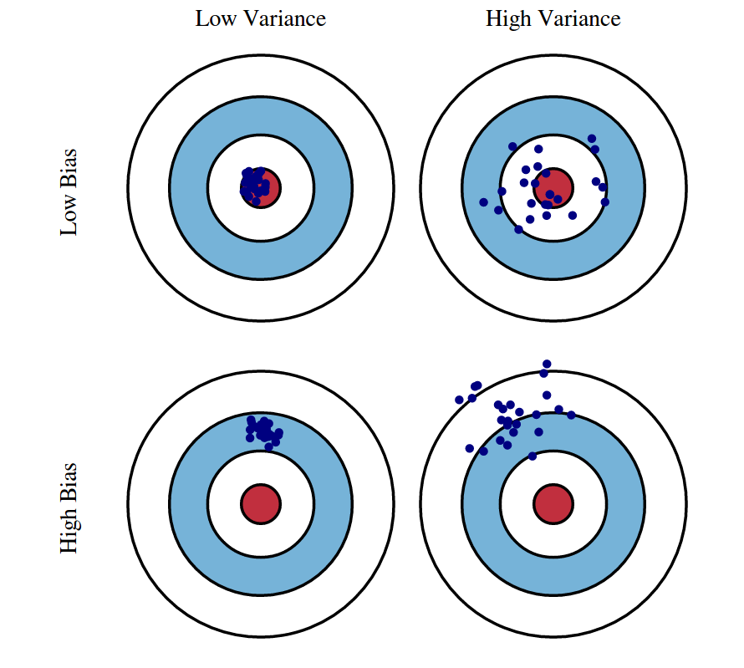
Bias and Variance

Slide 21
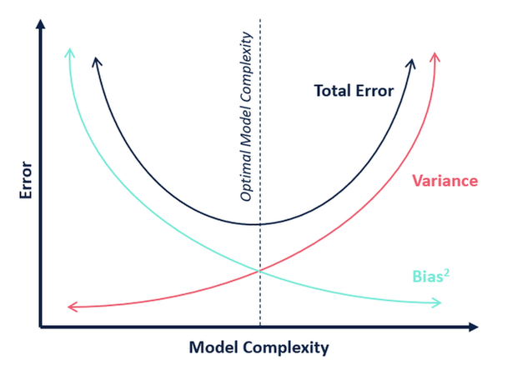
The Trade-off

Slide 22
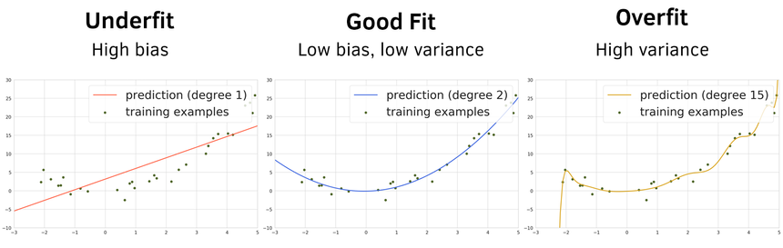
It works the same way as under and over fitting

Slide 23
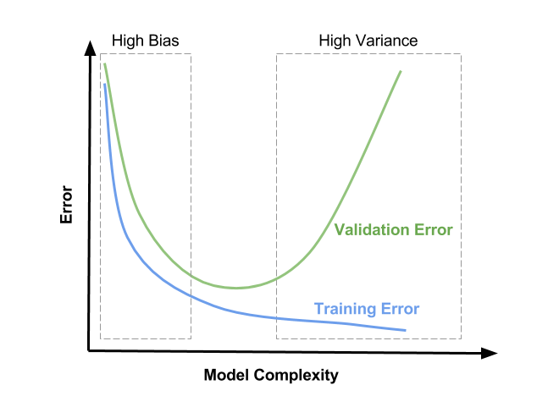
It works the same way as under and over fitting

Slide 24
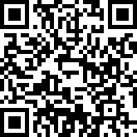
Next up
Keep working on case 3
Make your voice heard, evaluate my work (both if you are happy or not with it)

