Slide 1
Lecture 12
Model Deep Dive: Decision Trees

Slide 2
Today
Understand Decision Trees
Make a Decision Tree with scikit-learn

Slide 3
Decision Trees
A popular model
Can be used for classification and for regression
Easy to understand, but still powerful

Slide 4
General idea
We are going to build a series of Yes/No questions on the data.
Individual observations/predictions (X) travel down the tree depending on their own values
Once observations reach leaf nodes (aka the bottom) we make predictions (y)

Slide 5
Thinking time
How do we build the tree?
How big should the tree be?

Slide 6
2D Visualization
Let's build a tree by hand

Slide 7
2D Visualization
Can you see any problems with this approach?
Large gap example
Non-linear, diagonal example

Slide 8
Making splits
How do we decide what variable to split + at which value?
https://mlu-explain.github.io/decision-tree/

Slide 9

Entropy and Information Gain
Entropy is the diversity of our data at some node. The more diverse it is, the worse our predictions would be
Ideally, we will make splits that reduce entropy: this is what we call maximizinig information gain
There are algorithms such as ID3 or C4.5 that do this on any dataset for you

Slide 10
How predictions are made
When we decide to not split further, we have a leaf node. This is where we actually predict.
Classification:
  Assign a class (cat/dog) to each leaf. If an observation falls there, we classify it with the assigned class.
Regression:
  Assign a numerical value to each leaf. If an observation falls there, we classify it with the assigned class.
  Advanced-hacky approaches: build a regression model at each leaf.

Slide 11
Thinking time - When to stop?
When should we stop splitting the tree?

Slide 12
When to stop?
No clear formula. Another of those things you go by with experience and looking at your specific case
A few possible approaches
  Establish a minimum node size for splitting
  Establish a maximum depth for the tree
  Establish a minimum improvement in information gain
  Let the tree grow excessively and afterwards prune it

Slide 13
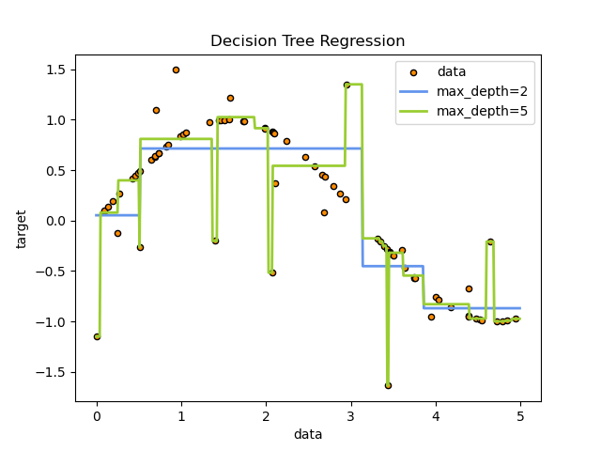
Why not go all the way?
Because of overfitting

Slide 14
Thinking time - Pros & Cons
Can you think of a few?

Slide 15
Pros & Cons
Pros
  Explainability: both of individual predictions and of feature importance (https://www.youtube.com/watch?v=H71-HS0HeFc)
  Does a great job at ignoring irrelevant features
  Can learn all sorts of non-linear patterns
Cons
  Rectangles and hyper-rectangles can make weird boundaries
  Does not learn outside the target range where it was trained
  Not very robust: small changes in data give you completely different trees

Slide 16
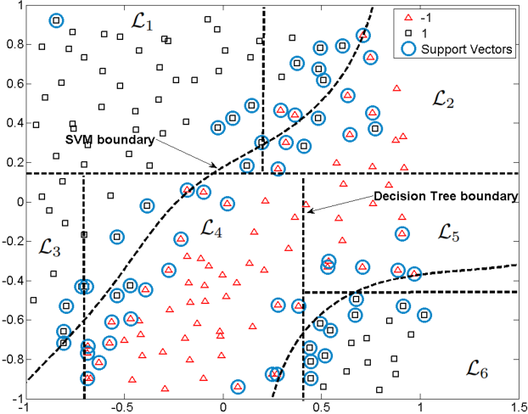
Rectangles and hyper-rectangles can make weird boundaries

Slide 17
Does not learn outside the target range where it was trained
A simple example
And a story

Slide 18
Not very robust: small changes in data give you completely different trees
https://mlu-explain.github.io/decision-tree/

Slide 19
Next up
Keep working on case 3
Review the notebook we have seen on how to make models for the Titanic challenge

