Slide 1
Lecture 11
Supervised Machine Learning

Slide 2
Today
Review Case 2 solutions
Supervised Machine Learning
Evaluation
What is learning exactly

Slide 3
Case 2
Level 1
  It's impossible to have a lower absolute cost (because of increased volume)
  But it's very possible to have lower cost per cont. (given new prices)
  Hence, there is a chance to reduce cost per cont. but not absolute. It is adviced to research further

Slide 4

Case 2
Level 2
  You all got it right
Level 3
  You all got it right

Slide 5
Case 2
Level 4
  Explore the price ranges, either randomly many times or in a structured way
  Optimize for each
  Leverage the results of all simulations to see what are possible outcomes of all scenarios
  Leverage the results of the simulations that share a common optimal dock combination to see what are the possible outcomes of THAT specific solution on all scenarios

Slide 6
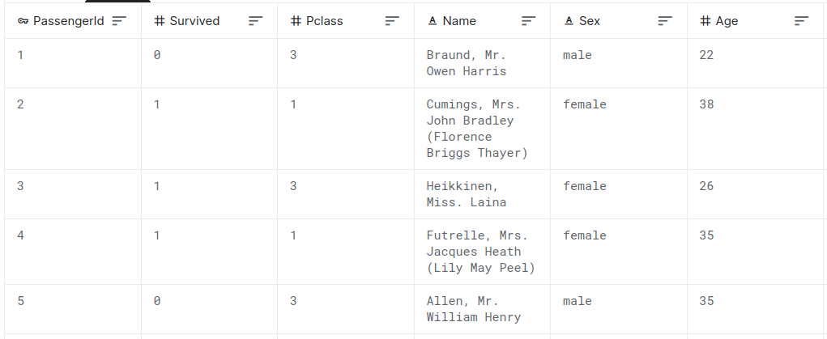
Supervised Machine Learning
Learn the relationship between predictive labels and a target label

Slide 7
Classification Problems
The target variable is categorical
Examples:
  Is this a spam email or not?
  Is this a cat or a dog?
  Is this English or Russian?
We measure the accuracy of predictions in different ways (more later)

Slide 8
Regression Problems
The target variable is numerical
Examples:
  How much is this house worth?
  How much will we sell next month?
  What will be the final grade of this student?
We measure the accuracy of predictions in through metrics like R2, RMSE, MAPE, etc.

Slide 9
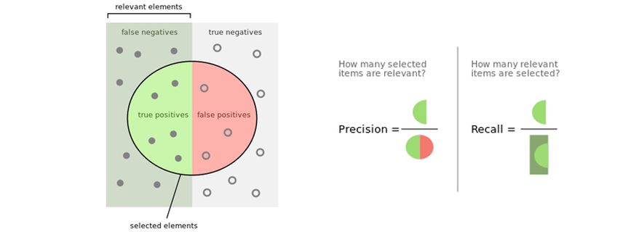
Classification Metrics
True | Predicted | Result
Cat | Dog | WRONG
Dog | Dog | RIGHT
Dog | Cat | WRONG
Dog | Dog | RIGHT
Cat | Cat | RIGHT
Dog | Dog | RIGHT
Usual metrics are:
  Accuracy
  Precision
  Recall
  F-1 Score
https://mlu-explain.github.io/precisin-recall/

Slide 10

A note on why accuracy is simply not enough
You want to train an algorithm to classify nose swab samples as COVID positive or COVID negative
You are given a labeled dataset with 10,000 swabs and the real result (positive or negative). 9,500 are negative, 500 are positive
Give me a very accurate classification algorithm without touching your laptop

Slide 11
Regression Metrics
Usual metrics are:
  Mean Squared Error (MSE)
  Root Mean Squared Error (RMSE)
  Mean Absolute Error (MAE)
  Mean Absolute Percentage Error (MAPE)

Slide 12
With metrics we build cost functions
Our prediction problem is actually an optimization problem in disguise
Minimize <pick your metric of choice>
Our decision "variable" is our algorithm choice
True | Predicted
Cat | Dog
Dog | Dog
Dog | Cat
Dog | Dog
Cat | Cat
Dog | Dog
Minimize the F1-Score of the Cat/Dog classification problem

Slide 13
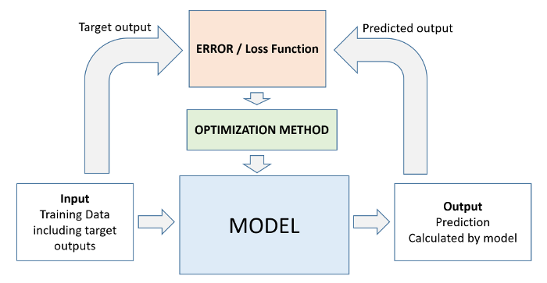
Training is optimizing
Training an algorithm means we modify it to minimize the value of the cost function
The tricky thing is how do we modify our algorithm
There are no perfectly defined rules, we rely on experience, heuristics and being familiar with different model families
LR example

Slide 14
Picking an algorithm family is constraining the solution space
There are infinite possible algorithms. We can't try them all
We need to decide which algorithms we can try
Our optimization algorithm helps us navigate these candidates
LR example
Simple DT example
Real function estimation

Slide 15
Algorithms
Many families with different properties
A few:
  Linear Regression
  Logistic Regression
  Ridge Regresion
  Lasso Regression
  Decision Trees
  Suport Vector Machines
  K-nearest Neigbours
  Random Forests
  Gradient Boosting
  Perceptron
  Convolutional Neural Networks
  Recurrent Neural Networks
  Long Short-Term Memory Networks
  Graph Networks
  ...
And the list goes on

Slide 16
Picking algorithms
No formal rules
You need to understand your problem and the algorithms to make a choice, and even in that case it's not completely obvious
There are a few algorithms that work very well in many areas. People tend to default to them
A few specific niche problems having specific algorithms that work very nicely with them

Slide 17
Preparing data
You need to decide what is your target (aka Y)
You need to decide what are your features (aka X)
Picking and creating features is important
Your tools here are
  Understanding reality
  Common Sense
  Exploratory Data Analysis

Slide 18
Data beats models
People obsess over algorithm choice and training
But good data is much more important
No fancy model will overcome a poor dataset
Better data beats better models almost every single time
Act accordingly: invest your efforts in getting good data. With that, even simple model will yield great results

Slide 19
Train and test
The data you have is typically split in (at least) two groups: Train and Test
Train is the data you will use to train (optimize) your model
Test is the data you use to measure the performance of your model with one of the metrics we saw
If you use all your data for training, bad things will happen (we will discuss later in the course)
https://mlu-explain.github.io/train-test-validation/

Slide 20
Now, let's play it forward instead of backward
To build a ML model
  You get data, define target variable and type of problem (class/reg)
  You decide what your features are and prepare the training and test sets
  You pick one or more algorithms
  You train them (optimize the cost function for your dataset)
  You measure performance (typically with a different set of data)

Slide 21
Next up
Enjoy a weekend with no case!
Review the notebook we have seen on how to make models for the Titanic challenge
Have fun with Neural Networks

