Slide 1
Lecture 10
Introduction to Machine Learning

Slide 2
Today
A first example on Machine Learning
AI -> Machine Learning -> Supervised Machine Learning
A bit of history

Slide 3
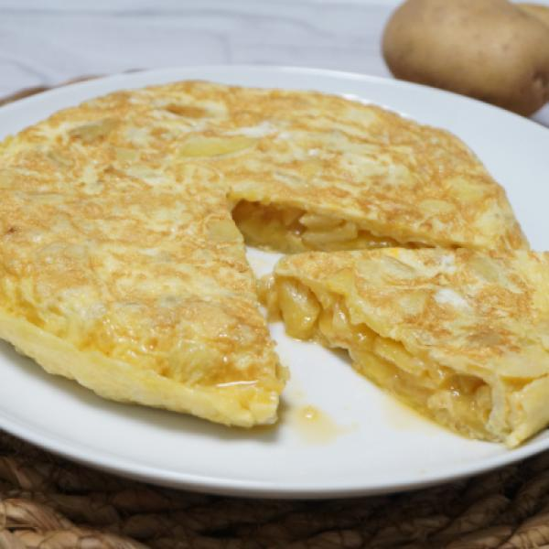
Tortilla
Popular as hell
Easy to make
Can you help me write some code to cook one?

Slide 4
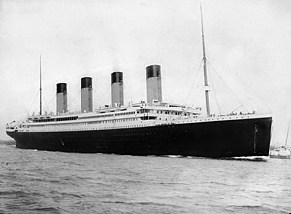
Titanic
Sank on 15th April 1912
2,242 people on board
Around 1,500 died, 800 survived
Can you help me write code to predict who survives?

Slide 5
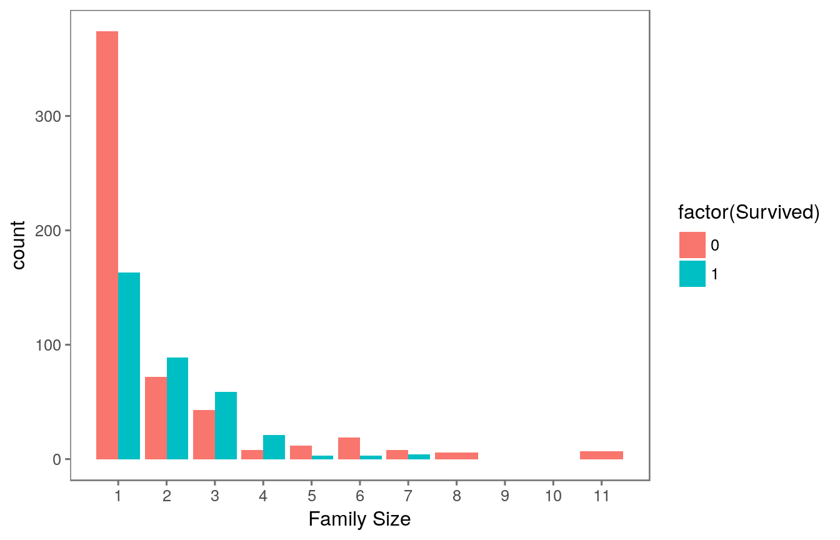
First clue

Slide 6
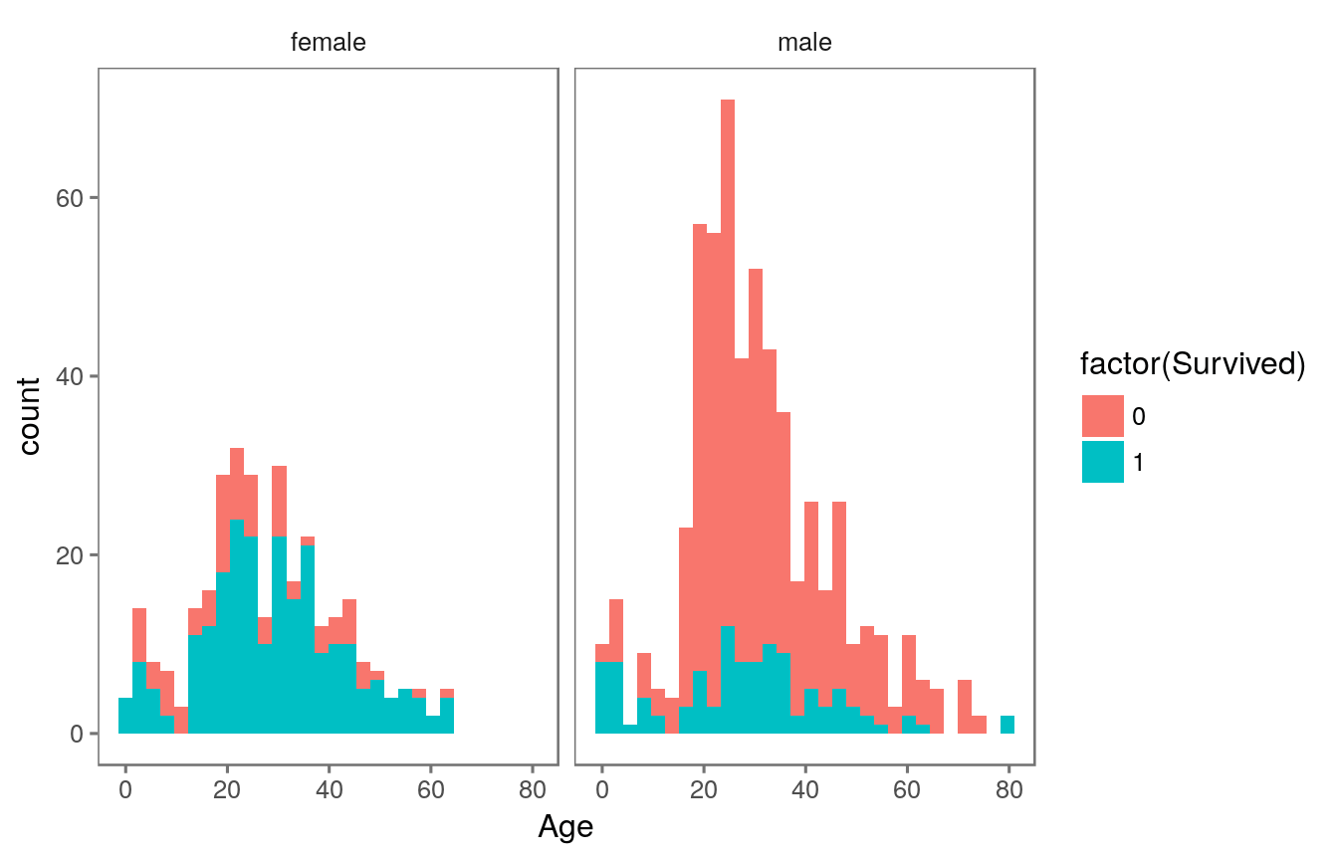
Second Clue

Slide 7
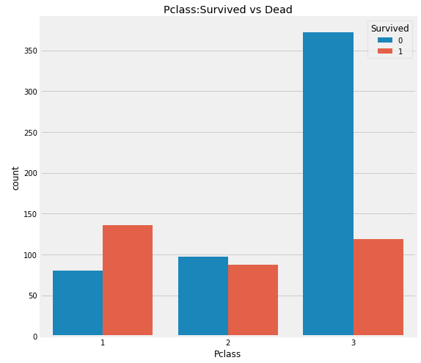
Third Clue

Slide 8
Titanic
Can you help me now?

Slide 9
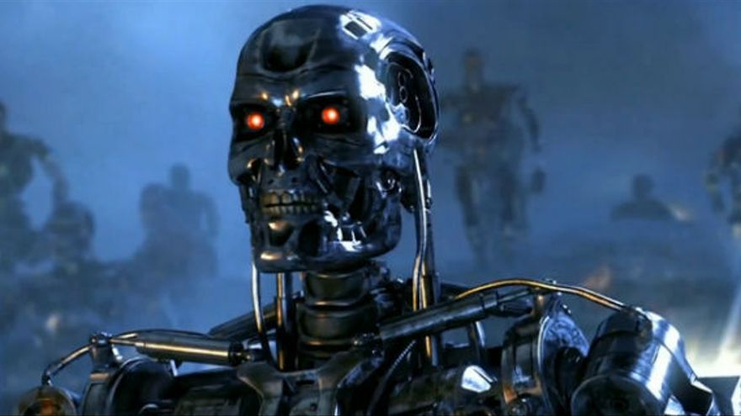
Artificial Intelligence
Ranks high on the most-misused-terms rankings
Generally, methods to replicate human intelligence in activities such as:
  Reasoning
  Learning
  Understanding information
Machine Learning is a part of Artificial Intelligence

Slide 10
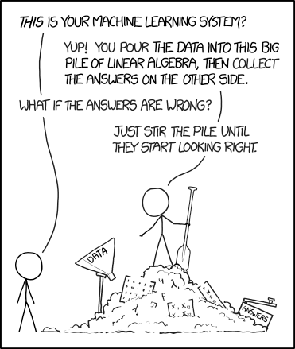
Machine Learning
Ranks high on the most-misused-terms rankings, although not as high as Artificial Intelligence
Field of research on algorithms that learn relationships and patterns on datasets
Jokes aside, great toolbox for many interesting problems

Slide 11
Examples
Financial Scoring
The thingy on your phone that recognizes people faces on pictures
Your Gmail spam filter
The banking algorithm that labels your transaction of being suspicious of Money Laundering/Terrorist financing
One of the best players of Starcraft II in the whole world
Self-driving cars
Detecting ilegally built swimming pools

Slide 12
Branches of Machine Learning
Supervised
  Predicting some data from other data
  Most popular
  What we will cover here
Unsupervised
  Uncovering unknown patterns in the data
Reinforcement Learning
  Training an interactive agent
  Agent interacts with the environment and learns from it

Slide 13
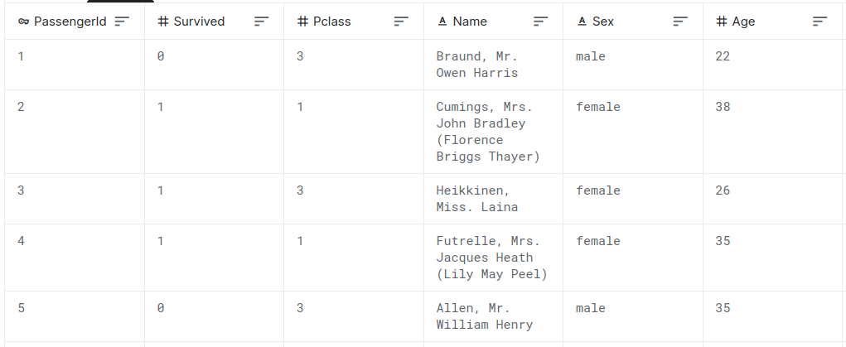
Supervised Machine Learning
Learn the relationship between predictive labels and a target label

Slide 14
Two families of problems
Classification: Categorical labels
  Survived/Died
  Cat/Dog
  Is English/Is Spanish/Is Chinese
Regression: Numerical Outputs
  Price of a house
  Temperature the next hour
  Number of cars that will go through Diagonal tomorrow

Slide 15
Possibilities
You are hoping there is a relationship between the explanatory variables (features) and the explained variable (target)
If no relationship exists, there is no miracle
If you have no data, you have nothing to do

Slide 16
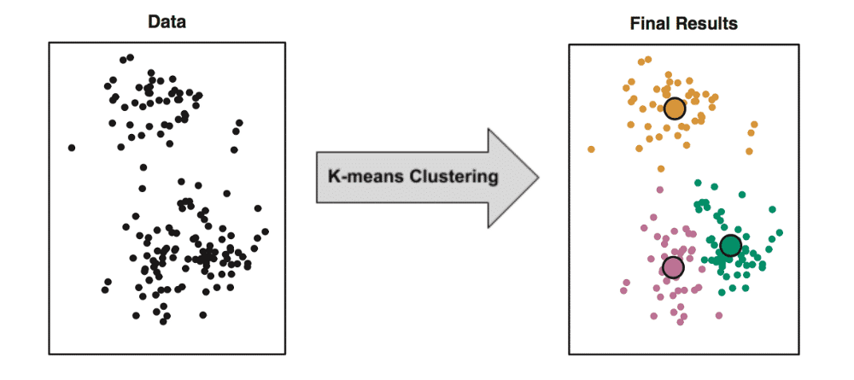
Unsupervised Learning
Nobody has labeled data (there is no target variable)
You don't really know what you are looking for
But we still want to spot patterns in a dataset
Typically associated with clustering

Slide 17
Possibilities
Helps you organize unstructured data (for instance, cluster a customer base depending on customer behaviour)
Reduce dimensionality (simplify data with many variables into fewer ones)

Slide 18
Reinforcement Learning
Innovative, but quite complex
We train an "agent" to make decisions
The agent is conscious of its environment
The agent is rewarded or punished depending on the result of his actions

Slide 19
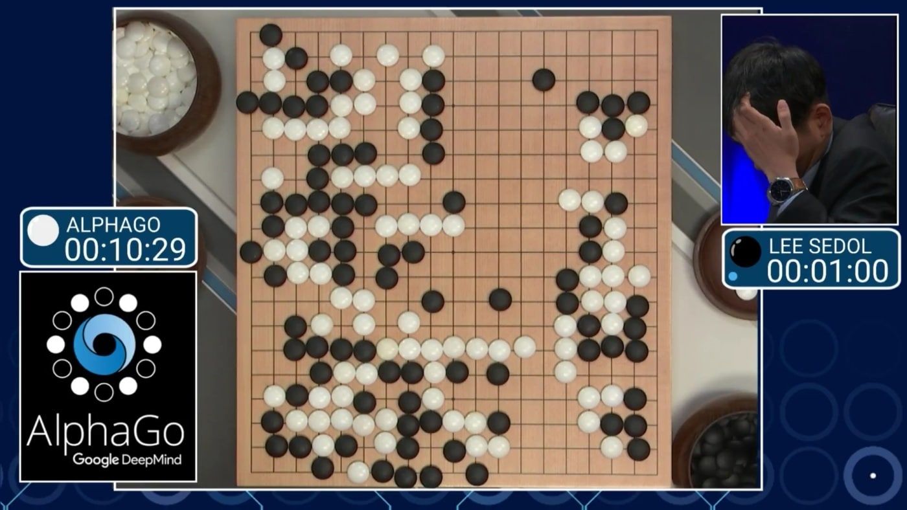
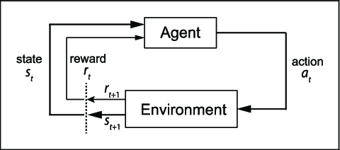
Playing Go

Slide 20
Possibilities
Replacing any decision maker
But modelling rewards and state is difficult

Slide 21
Thinking time
Could we apply Reinforcement Learning to case 1?

Slide 22

Why is it so damn popular?
Right place, right time
We had the math, but we missed tons of data and large computers
Now we have both!
It only takes a few lines of code to get started
Plenty of use cases

Slide 23
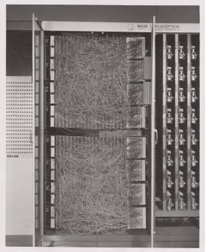
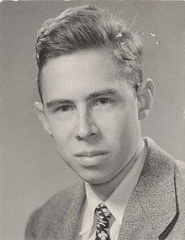
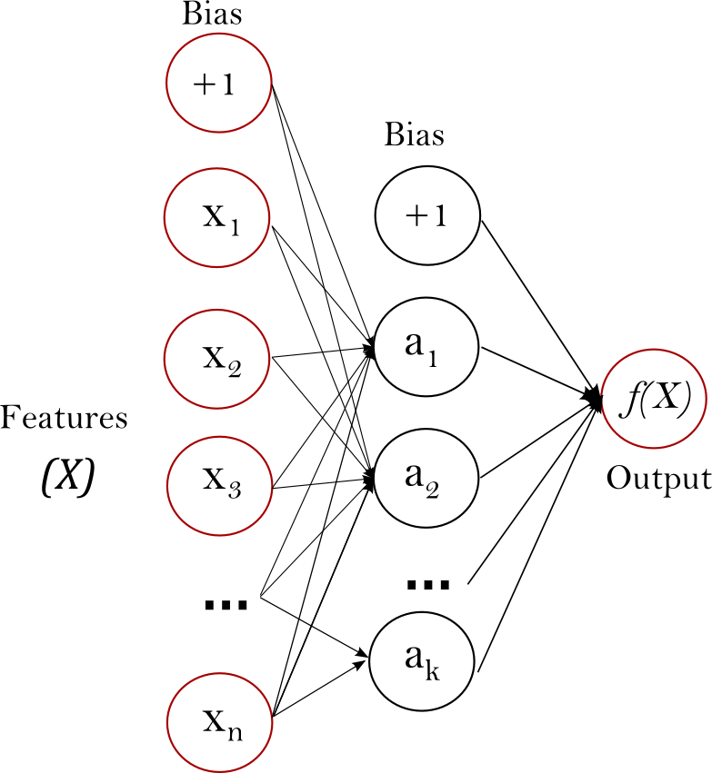
History (1950s)
We gave birth to computers
We were able to apply math that had only been theory so far
US Army invented plenty of $$$
We all got a bit hyped
“The Navy revealed the embryo of an electronic computer that it expects will be able to walk, talk, see, write, reproduce itself and be conscious of its existence.”
"Machines will be capable, within twenty years, of doing any work a man can do."

Slide 24
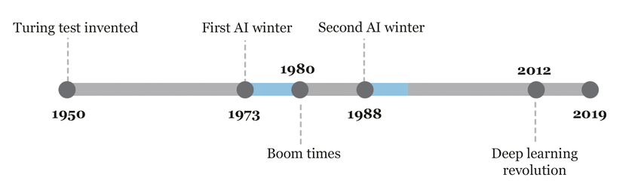
History (60s-70s-80s-90s)
Bust, and boom, and bust, and...
Excessive optimism was met with disappointment
Funding trends also influenced these cycles

Slide 25
History (21st Century)
IT systems have become the backbone of all human activity
Data is abundant and can be processed at reasonable costs
Breakthroughs keep coming, businesses and organizations succesfully deploy models in real life

Slide 26
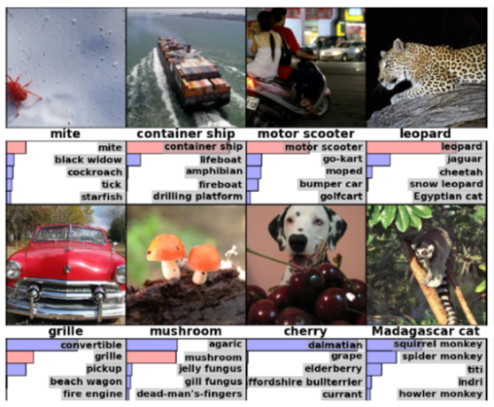
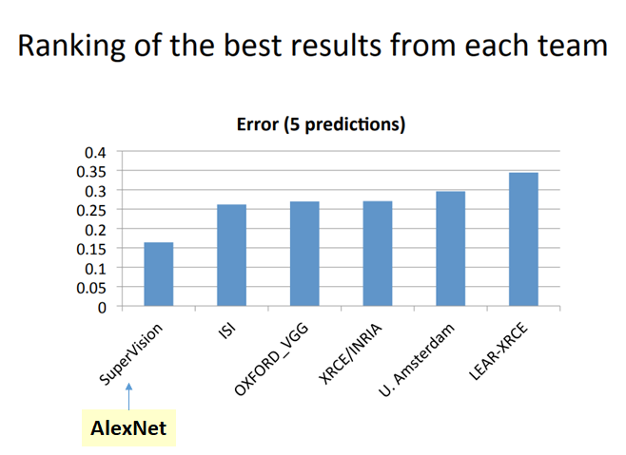
History (A breakthrough example)
https://www.image-net.org/

Slide 27
The Machine Learning loves competition
Researchers have regular competitions around benchmark datasets
Kaggle.com is the home of ML competition

Slide 28
With Power comes Responsibility
Screwing with ML can screw with your business
Zillow is a great example

Slide 29
Next up
Finish case 2
Visit Kaggle.com
(Optional) Login to Netflix and watch AlphaGo – The Movie

